Slide 1
QCon: Future of HCI
Multi-Modal Inputs with Magic Leap
Colman Bryant - @OldKingColman
Notes:
Thansk Courtney
“Hello everyone and welcome!” Thanks for coming!
Hope you’re having a great morning!
My name is Colman Bryant - I Lead Design for Interaction Lab at Magic Leap
Here today to talk to you about where we think the Future of HCI is headed
- Specifically relating to how we’re using new and different input modalities in different ways or in combination to move the ball forward

Slide 2









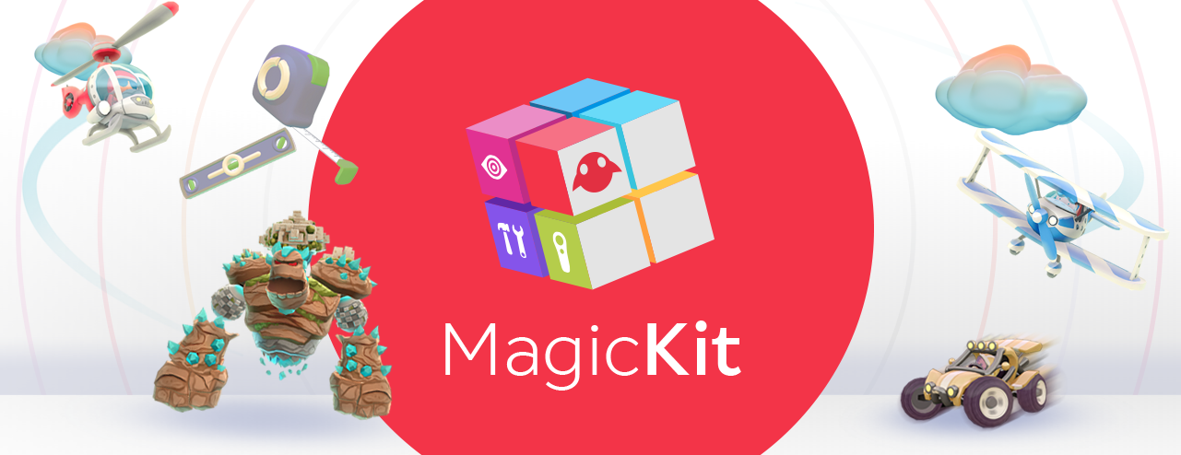

Colman Bryant
Lead Designer of Interaction Lab
Formal background in Computer Science, Art, and Music with a focus on Digital Media studies
11+ years in Game Industry working across all aspects of Game Design - Levels, Systems, AI, Inputs, Quests, Balance, Social...
Created and Lead several games and founded the Mobile Incubator at Hi-Rez Studios
At Magic Leap for almost 2 years, writing product goals and use cases and leading rapid prototyping efforts for the Interaction Lab.
Nerd.
Notes:
Name is Colman Bryant
Previously a game designer – 11 years in game dev before coming to ML – my childhood dream!
Did a bit of nearly everything a game design can do – Levels, Systems, AI, Inputs, Quests, Social systems, competitive gaming, casual gaming, prototyping and launching and maintaining shipped products
Founded mobile incubator at my previous company, Hi-Rez Studios
After shipping our first mobile game, felt I had checked all the boxes in game design and was looking for something new
Heard about this secretive startup called Magic Leap and was blown away. This is the dream!
Now here helping prototype the use cases of the future!

Slide 3
What is the Future of HCI?
Notes:
The “Future of HCI” is a big topic. Where to begin?
Like asking: What Can You Do With a Computer… in the future? … depends on the computer

Slide 4

Human Computer Interaction - the study of how humans interact with computers
Part Science - mechanics of Interaction, informed by purpose and adapted to our physiology
Part Art - appealing to “Human” psychology
Art with Purpose = Design
What is
HCI?
Notes:
Before we dig in to what this particular new type of computer I’m working on can do ->
Want to make sure we understand some fundamentals - Show of Hands - “What is HCI?”
“Human Computer Interaction” -> probably seems obvious, so let’s go a little deeper
Design => HCI is a discipline concerned with the design, evaluation, and implementation of interactions btw humans and computers
*But let’s go down one more layer. To understand future of HCI, we need to look at how Interactions work

Slide 5
To have Interactions, you must have…
Input - the human (or outside world) puts something into the system
Output - the computer responds and relays this to the outside world (Feedback)
The Physics of HCI
I/O
Notes:
Prereq for HCI is I/O
Kind of like the physics of HCI (Newton’s Third Law - Action/Reaction)
You can’t have Interactions without this

Slide 6
Human Provides Input
Human
(or Environment)
Computer
Feedback Loop
Computer Returns Output
Notes:
Human (or some external system) provides Input
<black box magic happens>
Computer Outputs a result
Up to the Human/Environment to decide what to do next
*Feedback Loop that’s fundamental to all computer-centric design

Slide 7
To understand the trends as we head to the Future.
We should first look at where we’ve been in the Past.
What’s the Future of
I/O?
Notes:
“To really know where we’re going, we need to understand where we’ve been”

Slide 8

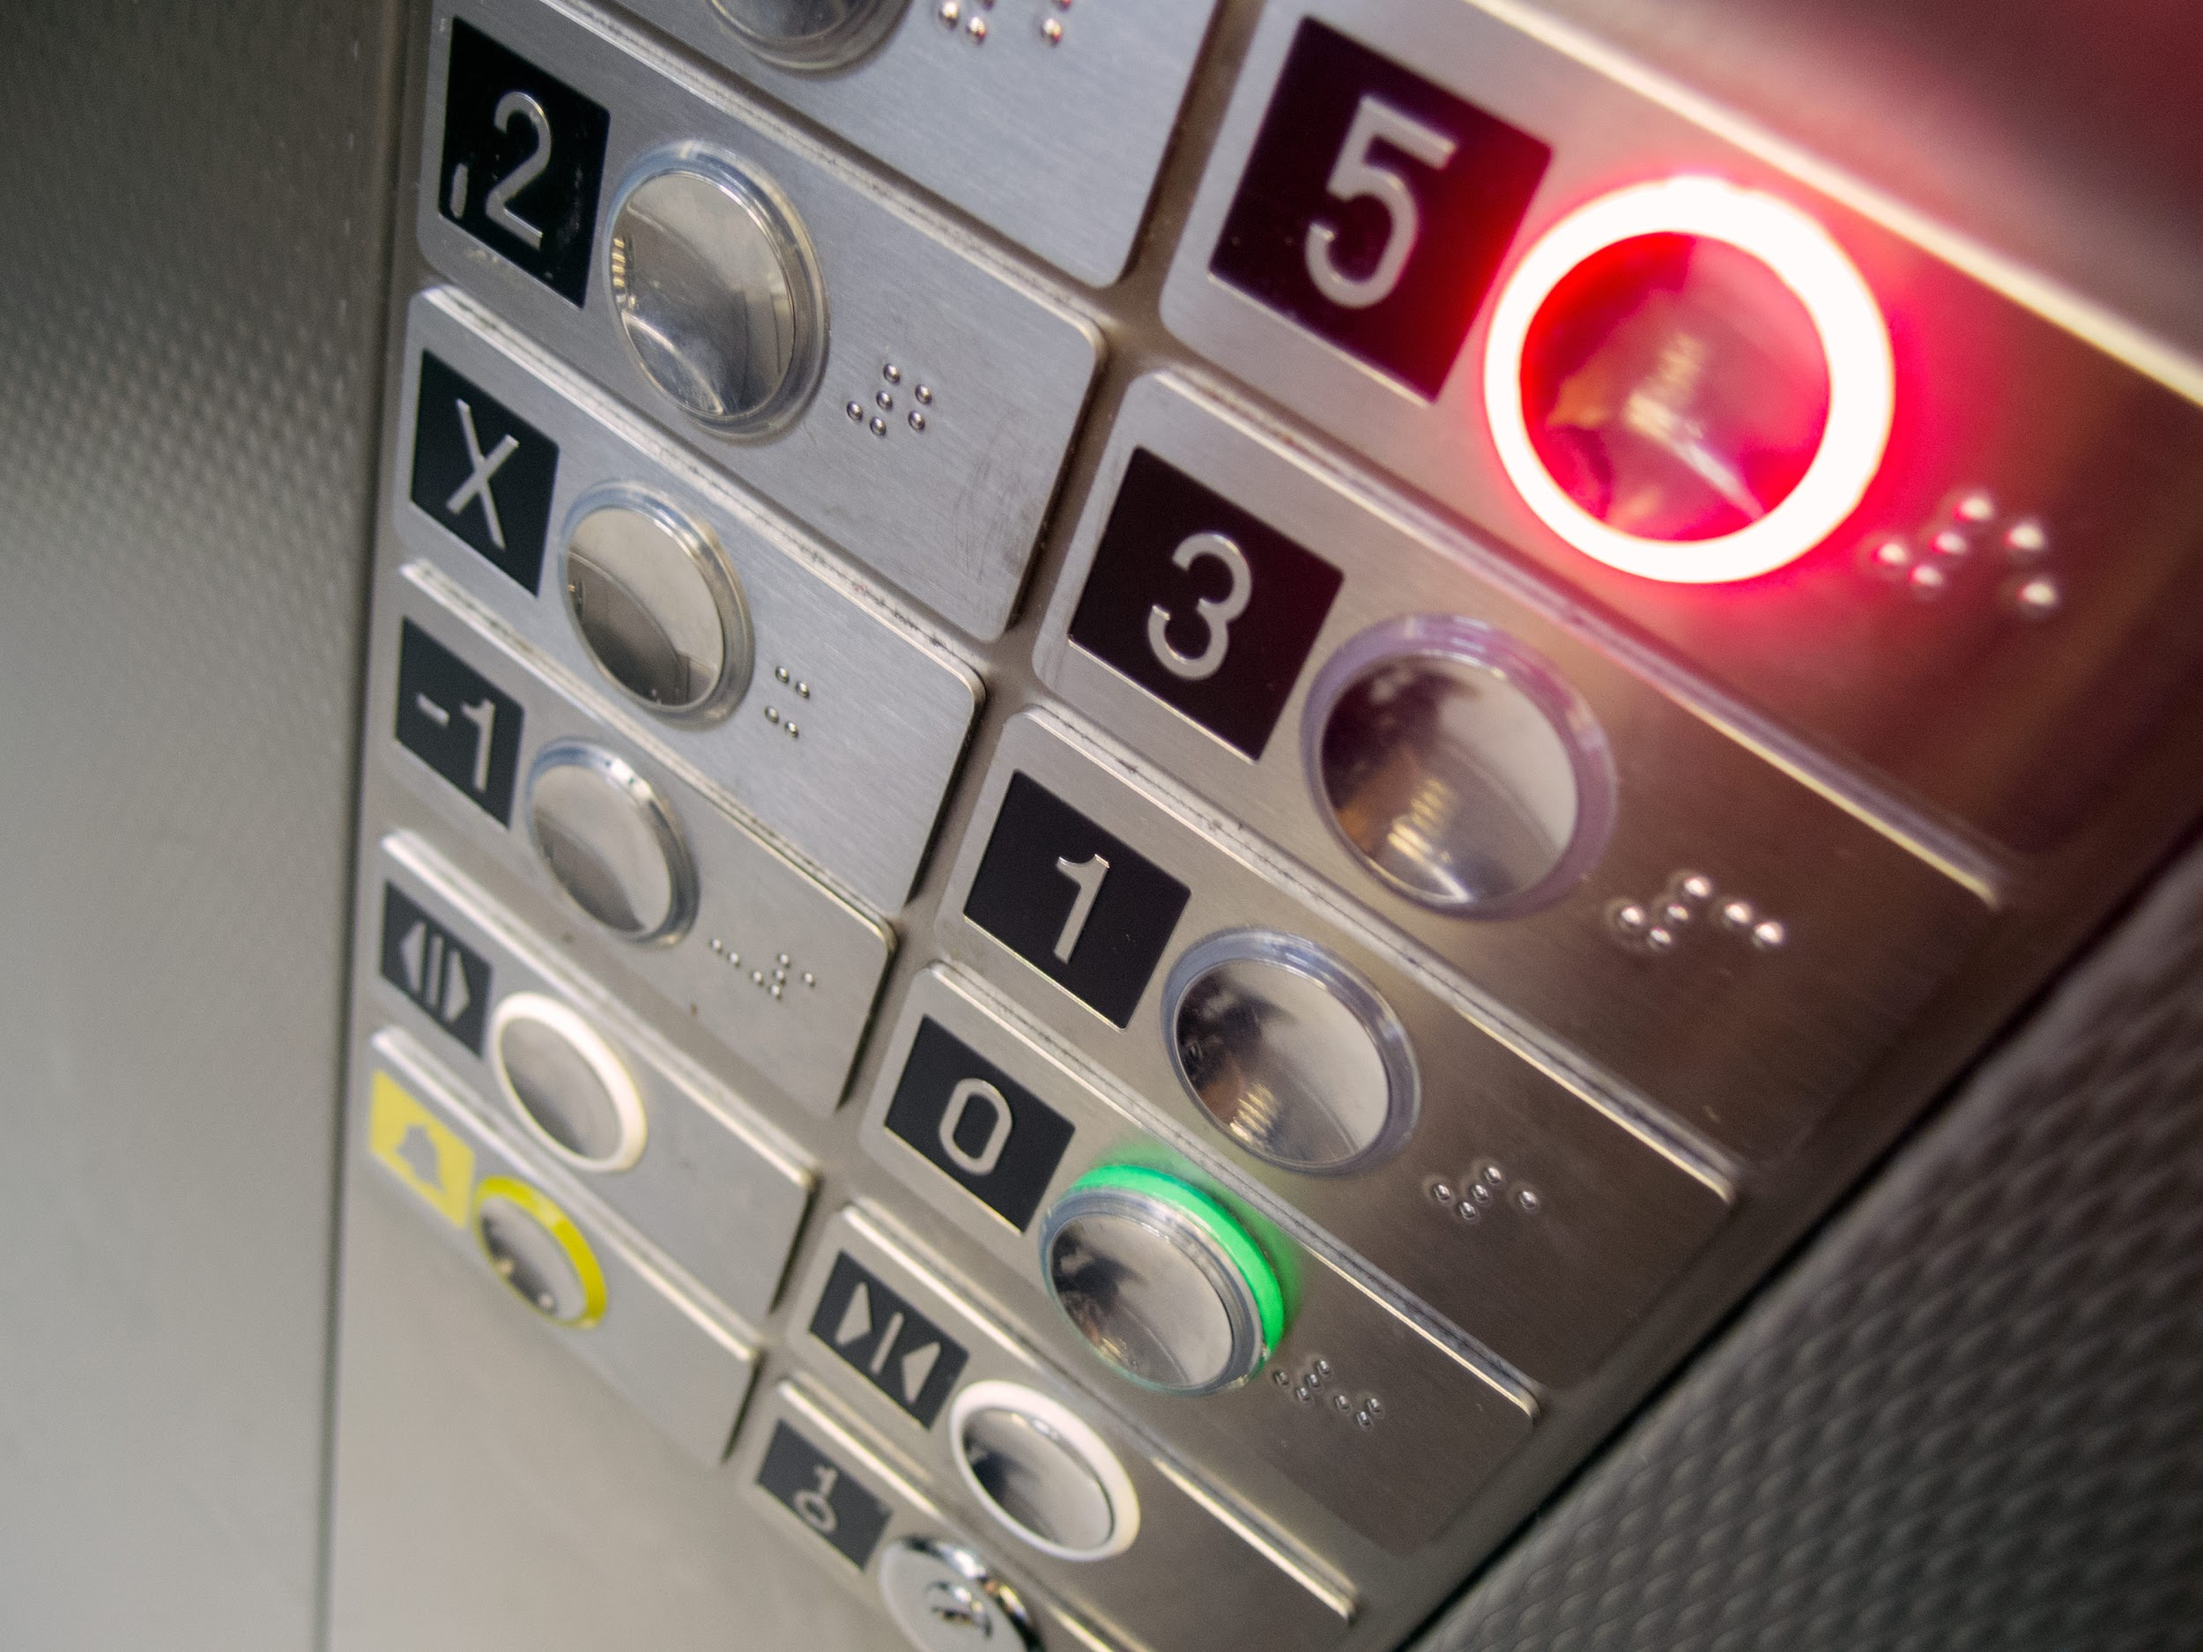
Definition
Affordance
Notes:
First a couple quick definitions. These are some terms I’ll be using going forward:
Any designers out in the audience? Show of hands
“Affordance” - common term in design circles. The properties of an object or system that enable (or reveal clues about) its usage
Good “Agency” - Tight pairing between action and reaction. “That good feeling you get you perform an action and when feedback is clear”

Slide 9


Definition
Input Modality
Notes:
Input Modality - a distinct input channel for a system
Keyboard
Voice

Slide 10
A Brief History of HCI
(and I/O)
Notes:
Let’s very quickly take a look at the history of I/O (and thus HCI)
Not going ALL the way back - Specifically beginning with “Electromechanical (and pure Electrical) Computers” (not the Abbacus or old pure mechanical just calculation machines)
Go through some previous I/O methods/tech and call out trends along the way (what was unlocked and how things improved for the humans)
*If you’re paying attention, you may have noticed I just answered the question, but let’s dig in anyways

Slide 11
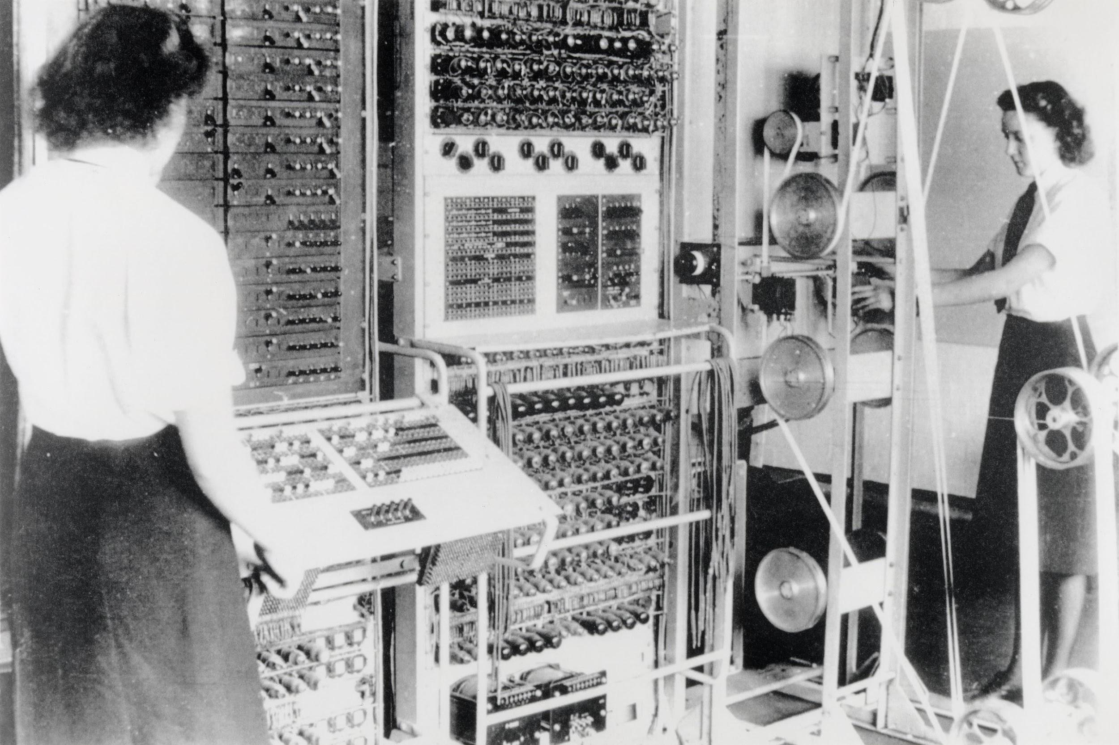
Notes:
Colossus (1943) - First Electronic Digital Programmable Computer
Built by the Brits - Used to decrypt German communications in WW2
Probably won Allies the war through technical advantage (being able to predict where the Axis would be)
Aptly named “Colossus” - giant, metal, not very portable, and a total beast to use
Inputs: Knobs and switches with paper tape loop for message
Outputs: Indicator Lamp Panel - manually captured
Poor usability - you can turn a nob or flip a switch, but the outcome of that was very unclear

Slide 12
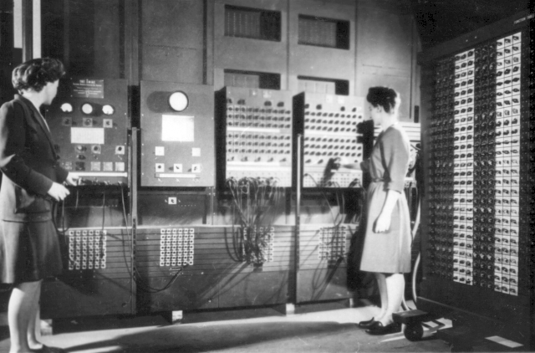
Notes:
Another room-scale computer you may recognize - the ENIAC (1945) - First Turing-complete “General Purpose” computer
mess of cables, wires, tubes, switches, and blinking lights
Press called it “A Giant Brain”
Took a Giant Brain to use it
Interface consisted of tons of switches and cables
NOT VERY USER FRIENDLY - Mapping of input to output very unclear
Only handful of people could use it - the creators or people were heavily trained
Affordances were vague, not “discoverable” - still not ready for primetime usage at large scale with untrained users
*BTW - If anyone ever says women have no place in tech, show them these last two pictures - these are some of the first computer programmers -> Betty Jean Jennings and Fran Bilas

Slide 13

Notes:
ENIAC again
Running a more complex program. You can tell by all the extra wires

Slide 14
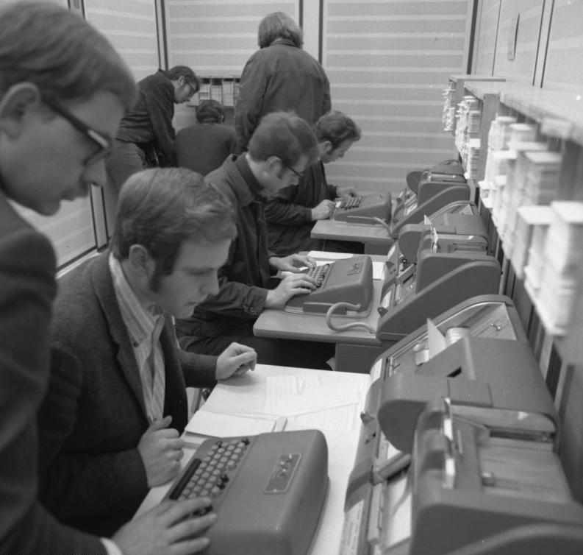
Notes:
Punchcard Interfaces - put a piece of paper in, get a piece of paper out
Slightly easier to use
Form factor is starting to look a little more like the modern PC
Inputs:
Keyboard based on typewriter to create sheets of paper - parts of “programs”
Feed sheet of paper into a larger “computer” to run programs
Outputs: other sheets of paper

Slide 15
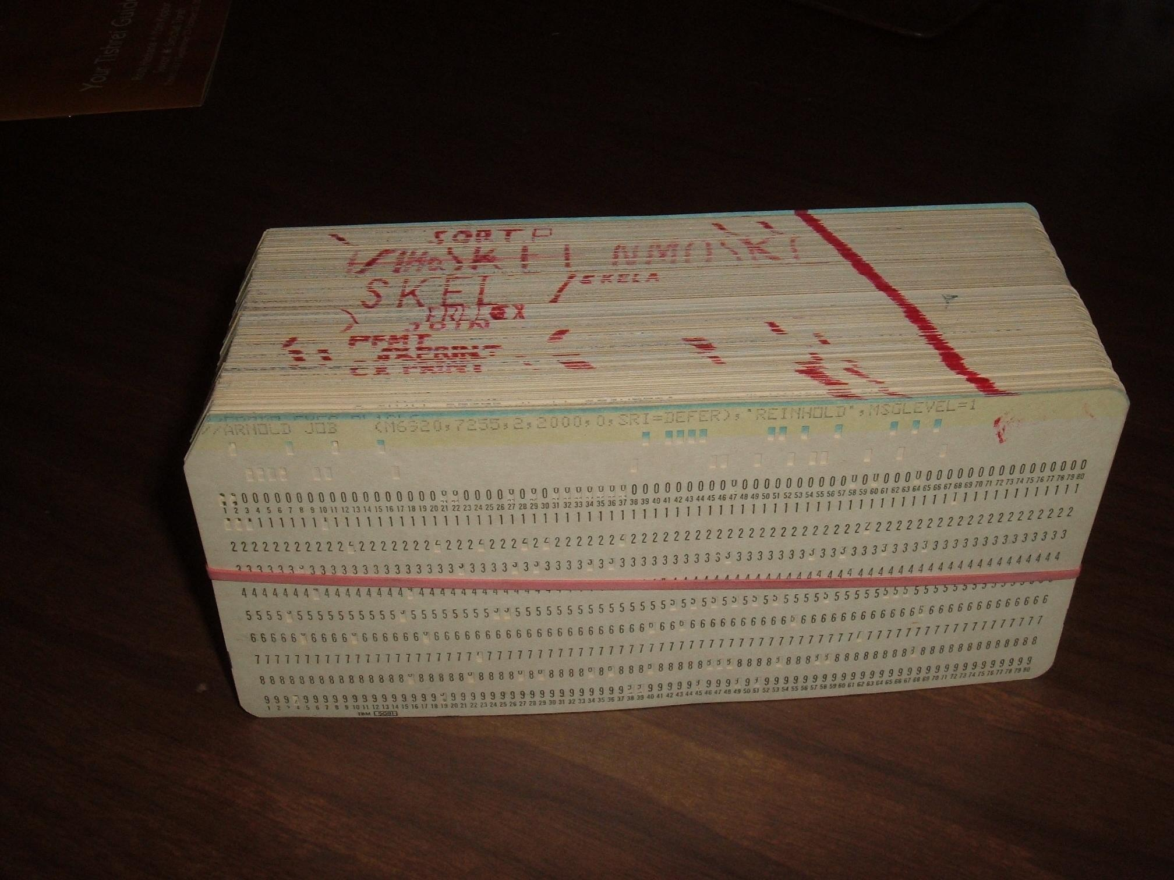
Notes:
A “Compiled Program” (deck of punch cards)
*Compiled like a deck of cards
*The “program” for nuclear simulations for Manhattan Project was around 1 million cards thick

Slide 16
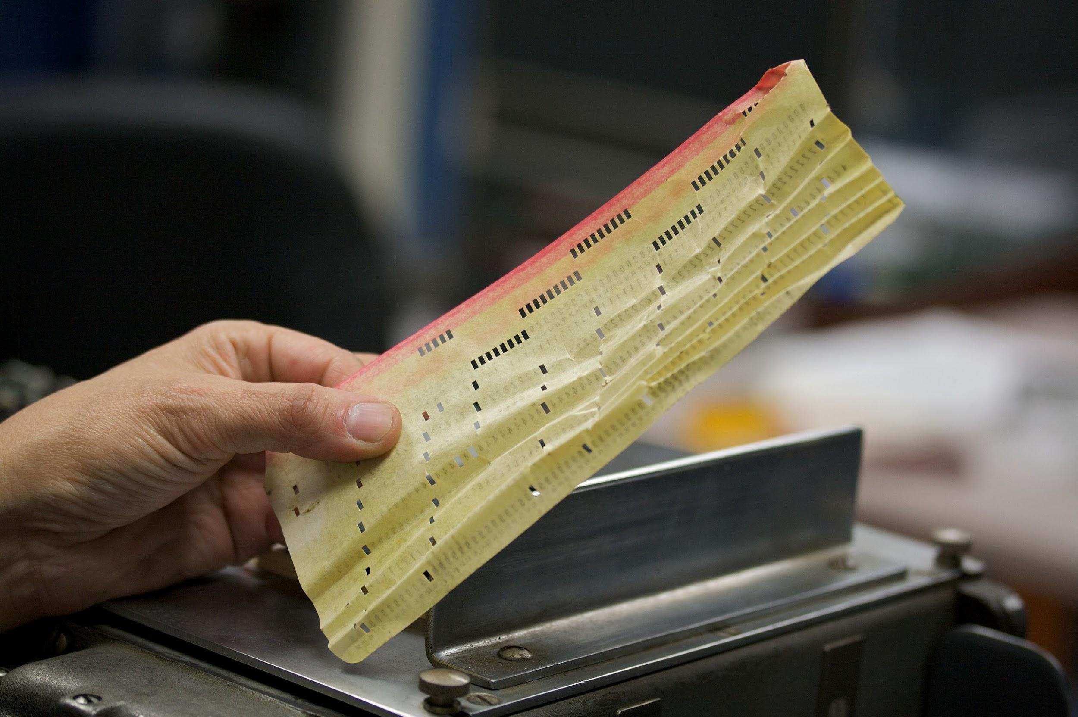
Notes:
Input and output was all on paper that was fed through a series of machines
*What could possibly go wrong?
Pain Points:
Tedious, error-prone (human and mechanical/material), slow to develop and iterate
If you made one typo, you had to restart the entire punchcard
Mapping of input to output very unclear
Still had to be a trained expert to use

Slide 17
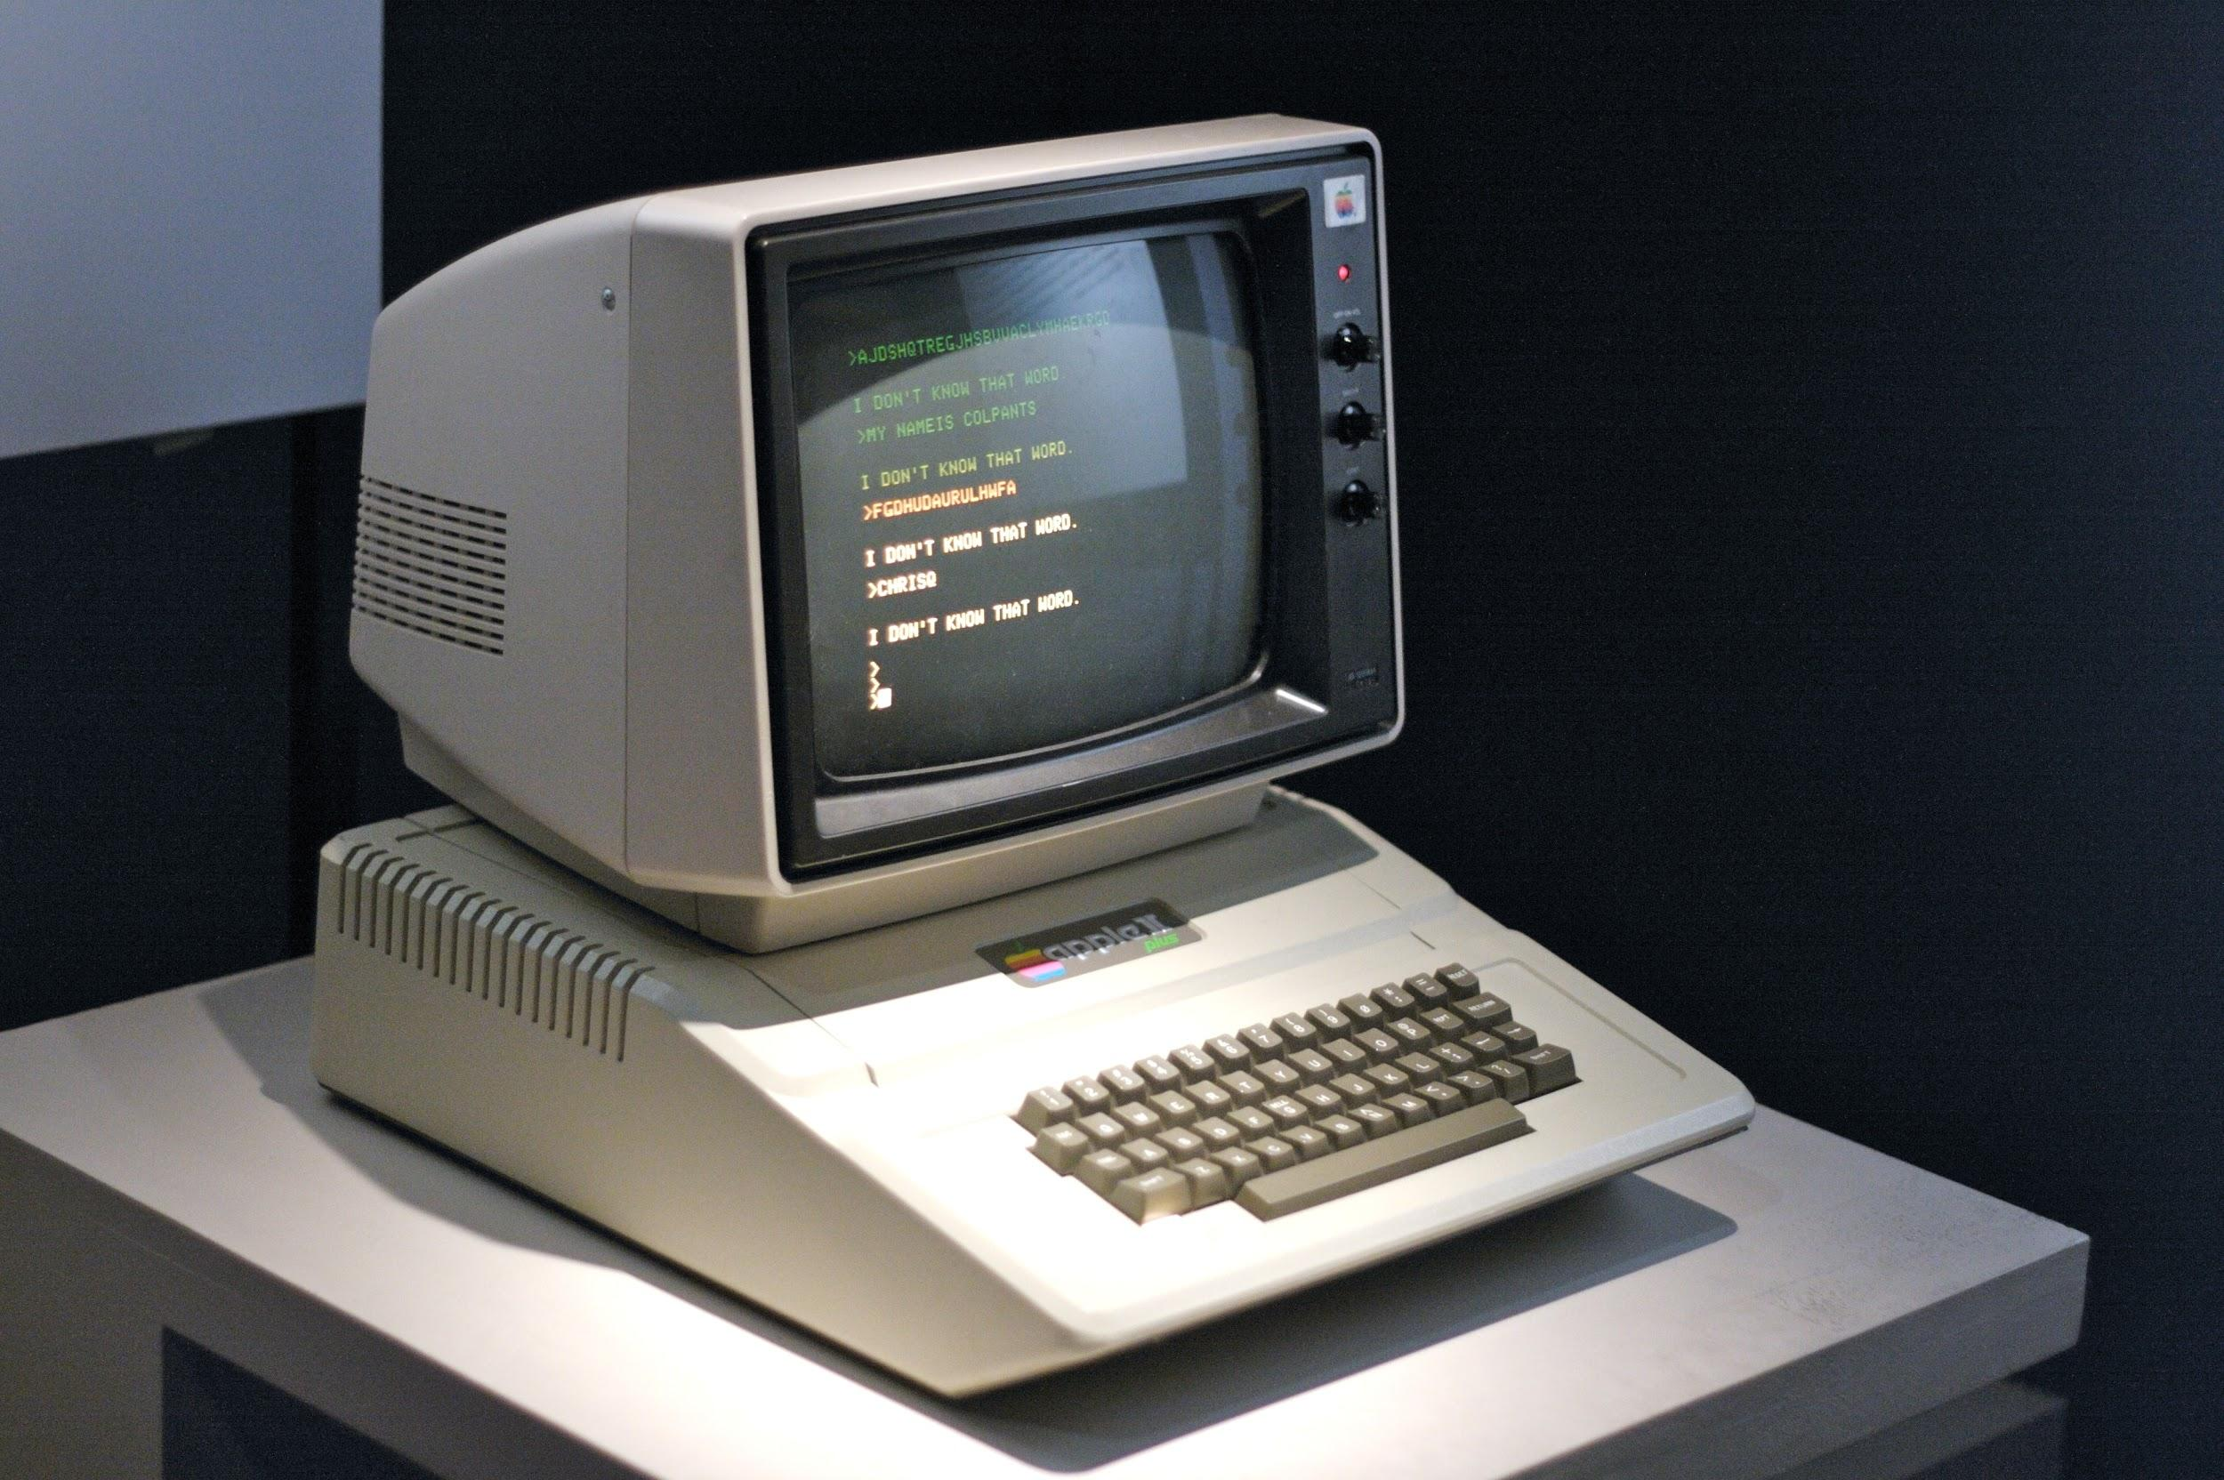
Notes:
Personal Computer - Apple II (1977) -> the next major milestone in HCI and I/O
Next major milestone in HCI (and I/O)
Inputs - Keyboard (again)
Now with improved Outputs - The Monitor!
Greater and more immediate sense of “Agency”
First real step toward the Democratization of computing - home consumer use!
No longer have to be trained to use a computer

Slide 18
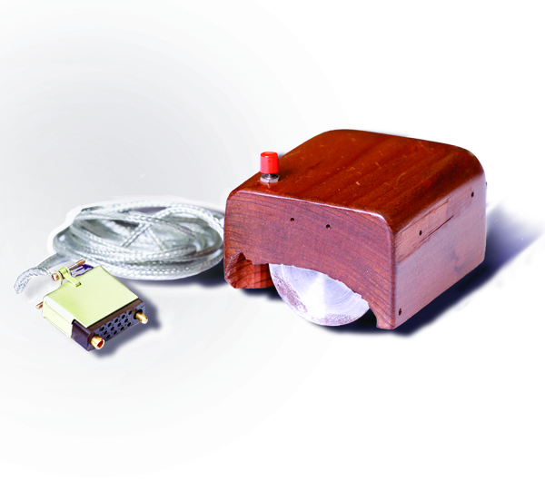
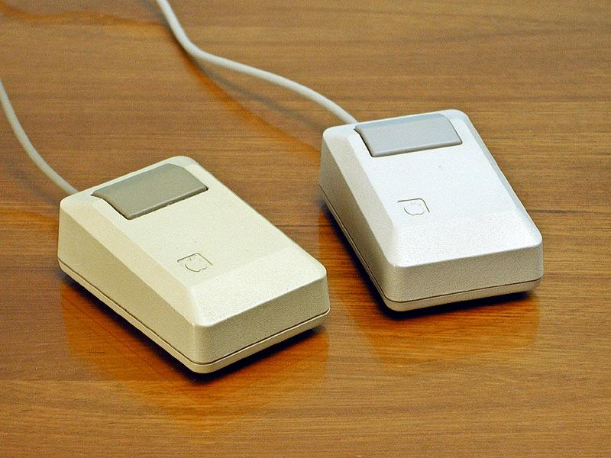
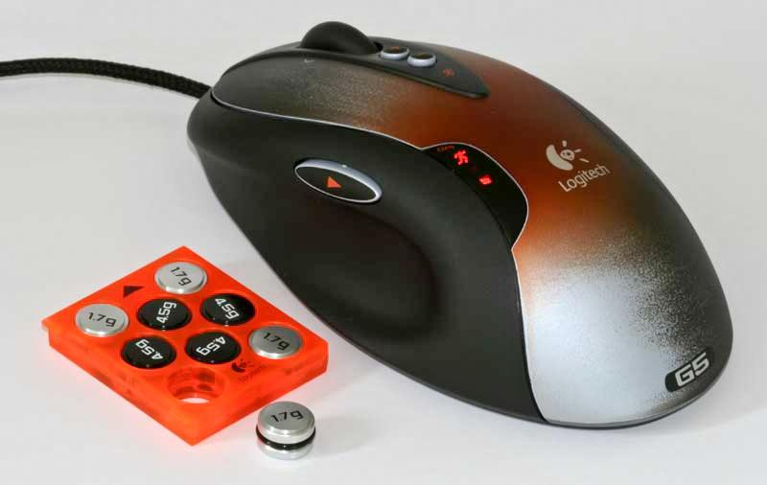
Notes:
Meanwhile fella named Douglas Engelbart was experimenting with a new type of input device for easily manipulating 2D graphical usre interfaces or GUIs
“The Mouse” - A game changer for HCI - used precise intuitive non-abstract 1-to-1 motion to control a cursor on a 2D plane
Left - (1968) “Engelbart mouse” - first prototype, made by hand
Right Top - (1986) First mouse many here likely used (for Apple Mac Plus)
Right Bottom - (2007 - the Evolution) Modern mouse with tons of extra widgets and customizable weights - same one I used at my last job
*Also Related to our “Future” trend - Note over time how the ergonomics improve - conforming the machine to better fit the human -> Comfort is starting to become a factor
Tiny hard-to-reach button and bulky mouse
Larger button, mouse is less bulky and angular, a little more flat
Ergonomic shape fits hand, lower resistance clicking, more buttons, scroll wheel, customizable weights
*In the land of the personal computer, the Mouse has iterated and improved, but for 2D targeting and selection, it has yet to be topped. It is the quality bar to beat

Slide 19
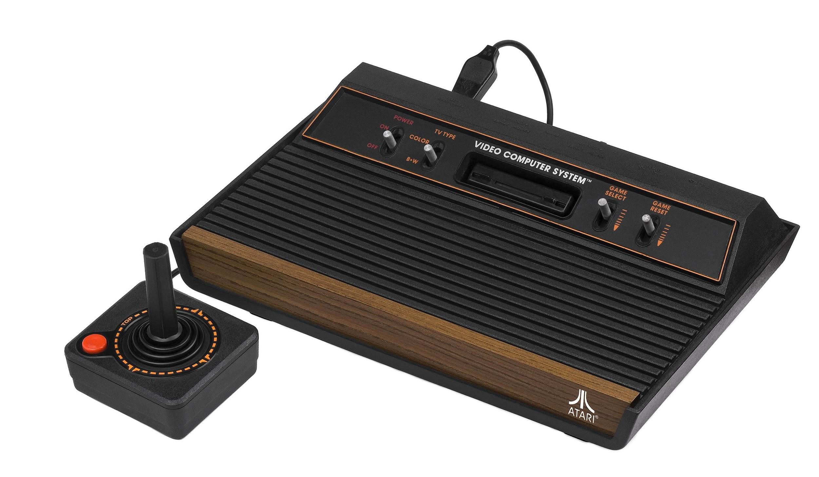
Notes:
*And then from there, things really start to explode - HCI (and I/O) advances much more rapidly, gets much more experimental, and input/output tools and methods become much more broad
Atari 2600 (circa 1980)
Features:
Input - (Wired) Game Controller with a 2-directional (2DoF) joystick and single button
Output - TV (w/ color video and audio)
*Add pic of TV with game

Slide 20
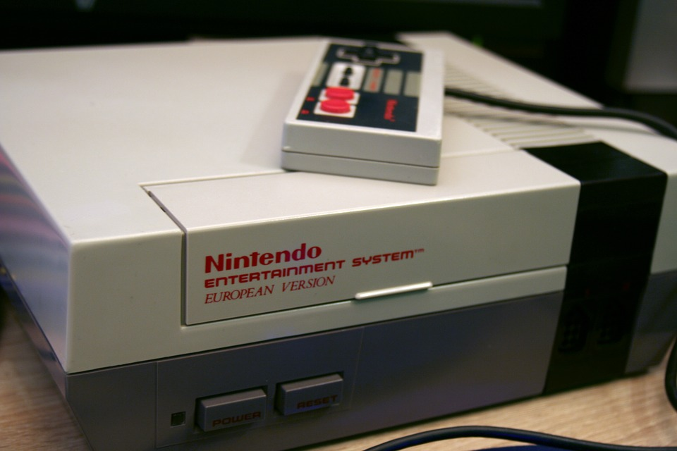
Notes:
NES (1985)
*This is why I’m here...
Input - (Wired) Game Controller with a 2-directional (2DoF) directional pad and MULTIPLE buttons
Made it possible to run AND jump (and shoot fireballs AND even pause your game!)
Output - TV (w/ even more colors and better audio)
*Note that modalities are increasingly becoming combined (hold button while directional pad and tapping another button)
*Add pic of TV with Mario

Slide 21
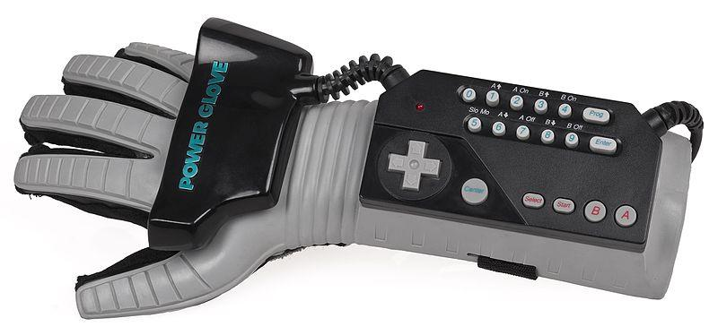
Notes:
Who remembers this one?
“Power Glove”
Didn’t exactly catch on, but you can clearly see the desire here
Creators were continuing to try to make the computer better conform to the human

Slide 22
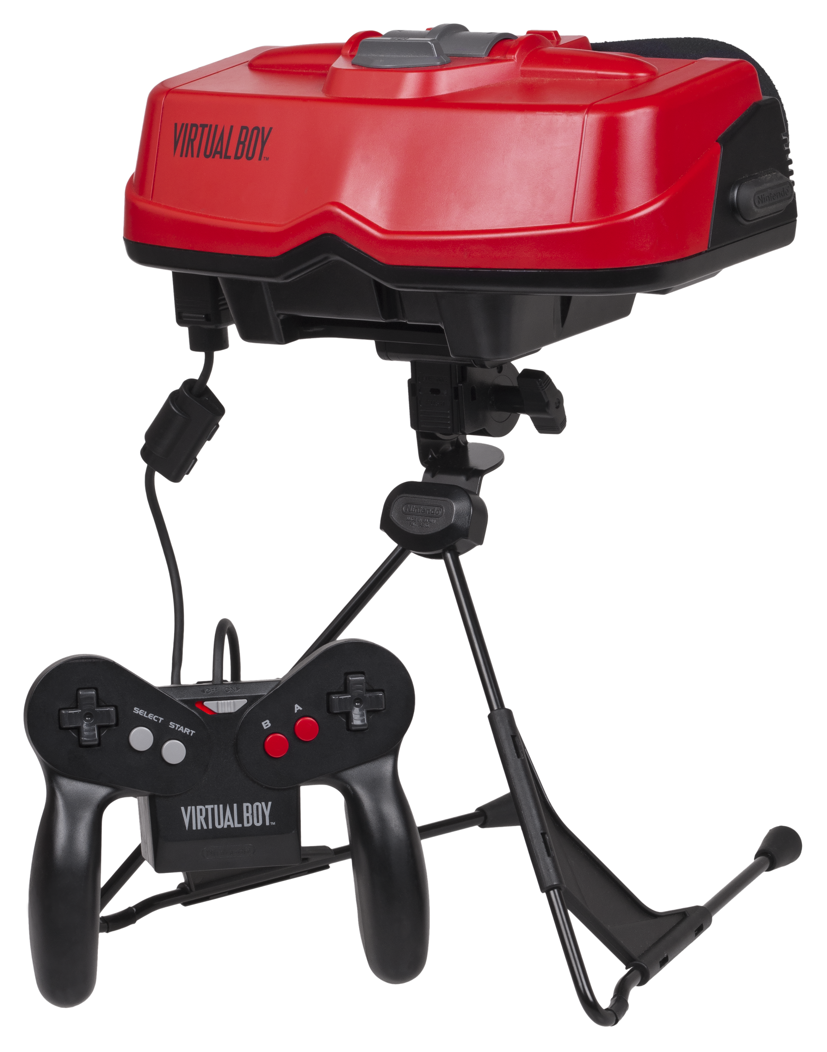
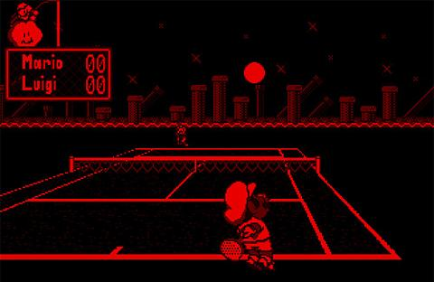
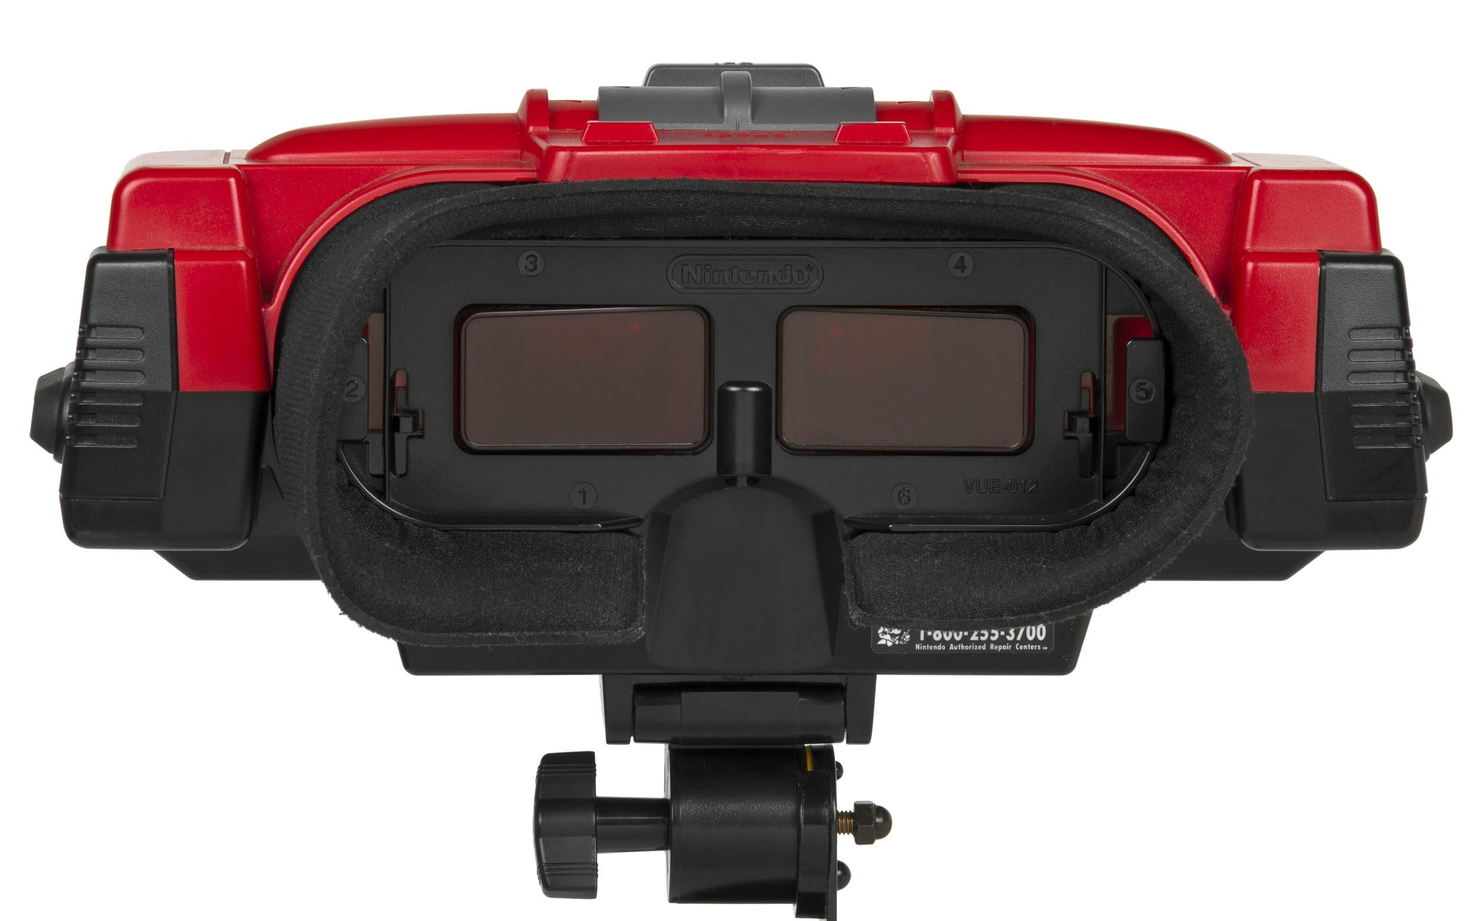
Notes:
What about this one?
Nintendo’s Virtual Boy (1995). The first major attempt to democratize home consumer VR
Did you ever try one?
Got a bad wrap, and the Inputs were still a fairly typical game controller of that era, but it actually did something really cool and novel on the Output (‘O’) side
Look through two eye pieces instead of a single screen
Enabled something totally new - Stereoscopic 3D graphics
Graphics were still 2D sprites, but had a somewhat believable sense of depth (even if it had color and resolution limitations)
*Not truly a Spatial Medium though - perspective was fixed. You’re peering through a periscope

Slide 23
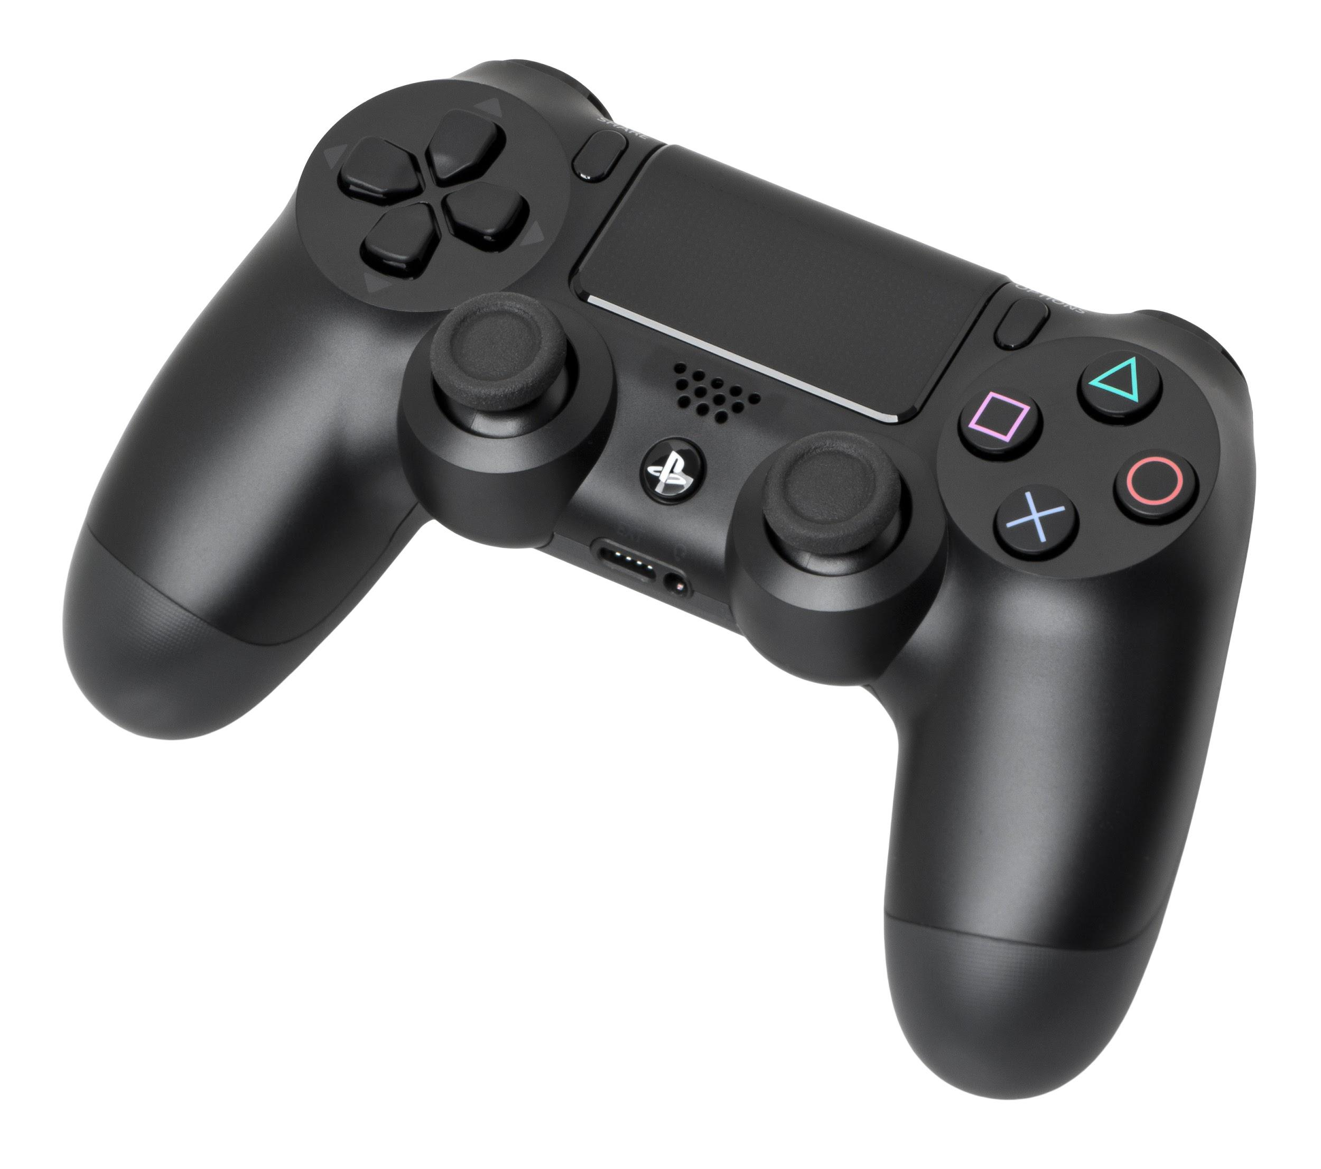
Notes:
Modern Game Controller - PS4 Dual Shock
w/ dual analog sticks
directional pad
A touchpad
12 buttons ranging in usage
Even “Wireless” to add convenience

Slide 24
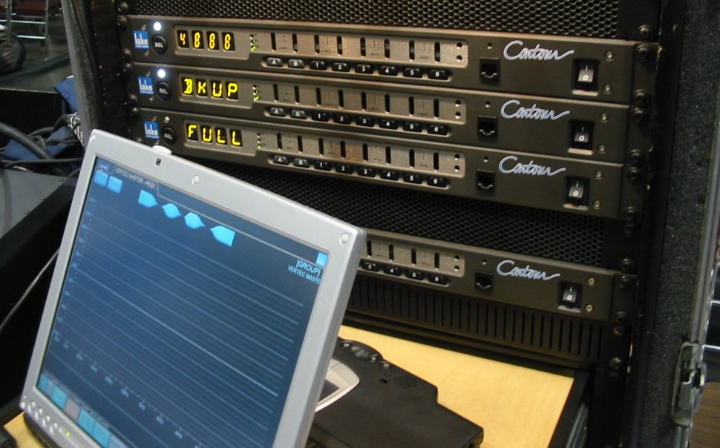
Notes:
Old style Touchscreen
Input done via the screen
Output also on the screen
Single point of contact
Low Rez
But proof of concept for “Physical Interactions” with the computer
*Saw these in public libraries (and check-out lines) mostly. Presumably because they were thought to be easier for the public to use than other keyboard-only and mouse-based systems -> again revealing our answer

Slide 25
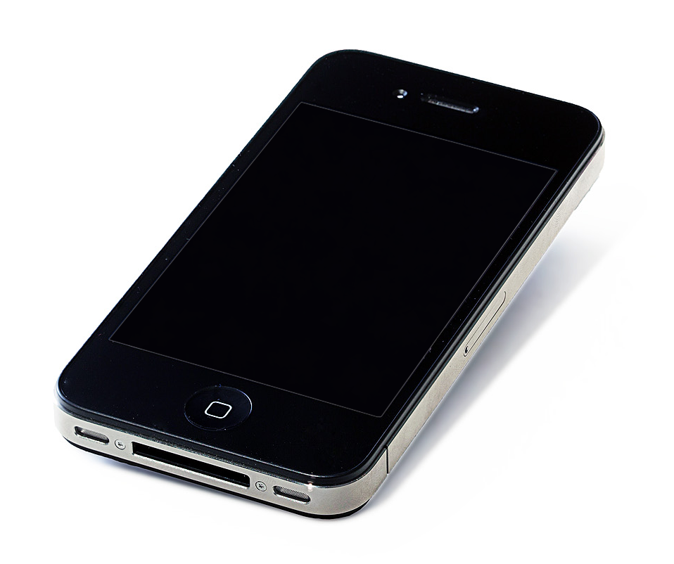
Notes:
Smartphones - iPhone 4 - where smartphones really started to break out
Multi-touch Screen - both an input and an output
Inputs: Gyroscope & Accelerometer, Compass, Mic, Speakers, Haptics
Outputs: Screen, Speakers, Haptics
Lots of input modalities enables TONS of use cases
Billions of users worldwide - nearly half the world’s population

Slide 26
Do you see the Trend?

Slide 27
HCI Trend
Potential Userbase
Accessibility
*Difficulty of Development
(for Us)
Time
Notes:
Trend is to make things easier for humans
*Worth noting, this makes the devs and computers have to work harder
-More work to embrace human element
-More input modalities
-More code to implement
“Cool, so now we know the future of HCI! Started with switches and tubes. Eventually we can assume things will “just work” like magic. Humans control computers with their minds.” -> Stick around for the next talk for a really cool example of that
And why does Accessibility matter?
*Set up fade anims for topics on left Accessibility
-> Increases Number of Potential Users -> great if you want more people to actually benefit from computers
-> but also becomes more difficult to develop for
Flipping bits isn’t that hard if you just focus on the computer’s language
Doing it in a way that makes sense to complicated emotional humans requires thought and understanding of psychology

Slide 28
Thank You!
Notes:
OK, and that’s the future of HCI!
“Questions? I think we have time for one or two!”

Slide 29
Just Kidding!
Notes:
Nah, just kidding!
Put those hands down! We haven’t actually gotten to the cool future stuff yet!

Slide 30

Bad Design Has
Consequences
Notes:
*Not in the context of computers, but…
“Let’s talk about what happens when affordances are unclear” (aka bad design)
“Who has this happened to? Raise your hand. We’re all friends here, we won’t judge”
“If your hand isn’t up, you’re probably lying, and I’m definitely judging you…”
*Classic Example of a bad user interface in everyday contexts - The unclear door handle!
You walk up to a pretty door with a nice pretty handle. Polished. Symmetrical. Seems nice! But how do you use it?
This is more minor day-to-day eample - If you choose poorly, maybe you spill your coffee, faceplant, or look like a fool (even though it’s actually the door designer’s fault, not yours)
BLAME THE DESIGNER
But still annoying and easily avoidable if the designers had thought more critically about how their interface might be perceived by uninformed humans

Slide 31

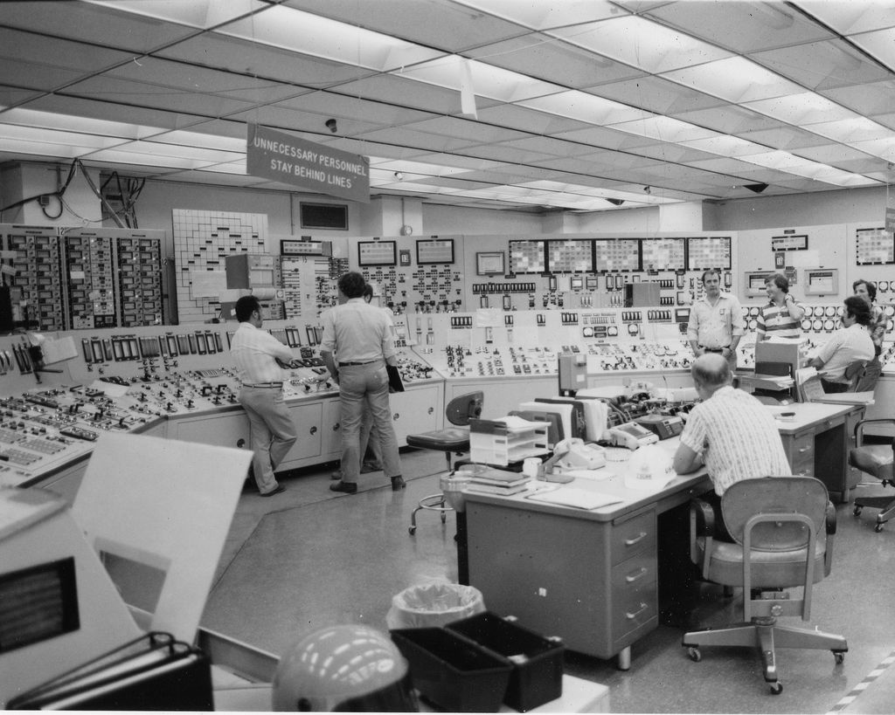
Bad Design Has
Consequences
Notes:
More severe contexts - Can have potentially devastating effects
Does anyone recognize this place?
Three Mile Island - site of the worst nuclear disaster in history on American soil
The cause?
This is the control room...
-> A legitimate issue arose (failure of a non-nuclear secondary system), followed by a pilot-operated valve getting stuck open in the primary system
Plant operators didn’t notice due to an ambiguous and unclear interface (hidden warning light and lack of adequate training to look for it)
A confusing UI compounded by lack of training allowed things to go too far, which resulted in large amounts of radioactive waste escaping into the surrounding environment
Take a look at that control room setup. Does that look user-friendly to you? Are the important inputs and outputs intuitive?
*Good design can not only reduce chance of error but also can mean less training is needed
*Could your industry or company have a “meltdown” of its own as a result of an unclear interface or loss of training?
-> It’s really important to have good clear HCI!

Slide 32
Usability Matters
Notes:
OK Then! So we now see legitimate reasons why HCI needs to trend the way it does
Democratize access to computers - great for business and growth of the human species
Minimize errors - it’s always good to not accidentally release radioactive waste into your neighborhood

Slide 33
Magic Leap to the rescue!
Notes:
This is where Magic Leap comes in!

Slide 34

Our Mission
We harmonize people and technology to create a better, more unified world.
Notes:
Our goal is literally to make HCI take the next big “leap” along its trajectory into the future!
Democratize computing so everyone can use them (including the disabled)
Make computers more natural
Make them more mobile
Make them more comfortable and ergonomically friendly
Approach computing in a more ethical human-centered way

Slide 35
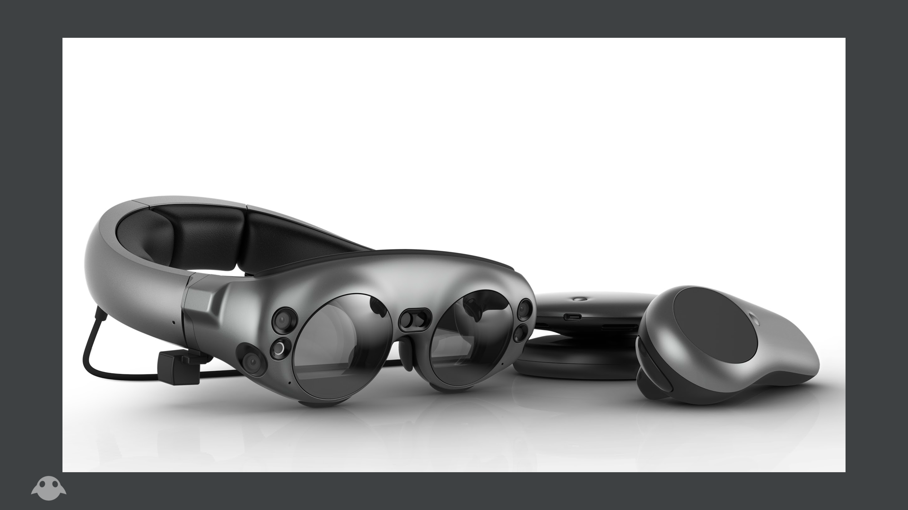
Magic Leap One
“Creator Edition”
Notes:
Meet Magic Leap One!
Aka “Magic Leap Creator Edition”
Our first public offering
A dev kit for the future
This is a “Mixed Reality” device
*What can it do?
*What I’s and O’s does it support?

Slide 36
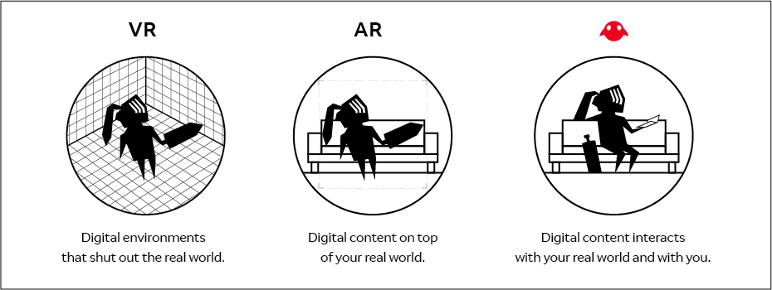
Notes:
First, let’s make sure we understand this term “Mixed Reality” that gets tossed around a lot for this medium
Some also call it “Spatial Computing”
I personally consider that more of a “class” of mediums (that includes MR as well as VR)
Presenting: “The Reality Continuum”
Common way of explaining mediums in XR community
*I actually personally hate this chart. These things don’t all belong on one axis, because AR is not a step between VR and MR. It’s a prereq for MR that has nothing to do with VR. This isn’t actually a continuum...

Slide 37
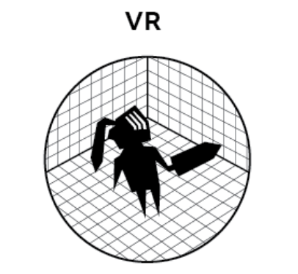


Spatial
We Are Here!
(chillin)
Virtuality
Reality
Non-Spatial
Notes:
It’s actually two axes: Spatial vs. non-spatial and Virtual vs. Real
Spatial = Computing in Space and with depth
Allows movement through space
High Spatiality = As you move and look around, your content appears “fixed in place” relative to the world (whether it’s a virtual or real world)
Affordance of motion/mobility? Can unlock new kinds of experiences and use cases when “placing content around you”
Very Spatial = Awareness of environment. Content doesn’t just track correctly as you move, but it also follows rules
Virtuality = How much is digitized
VR = ALL Virtual! The real world is cut out. Has some great uses, but also has some problems
When you can’t see your environemnt, you trip on chords, walking into tables, can’t see your friends
Feel disconnected from your world
Comfort (and nausea) issues
MR = Mostly Real (with some virtual sprinkled in). Solves many of the above issues.
We also specifically care about comfort and nausea. One of our core MO’s is to make our computing devices as wearable and phsiologically friendly as possible!
OK, better chart!

Slide 38
Digital Content that Follows the Rules of Reality

Slide 39
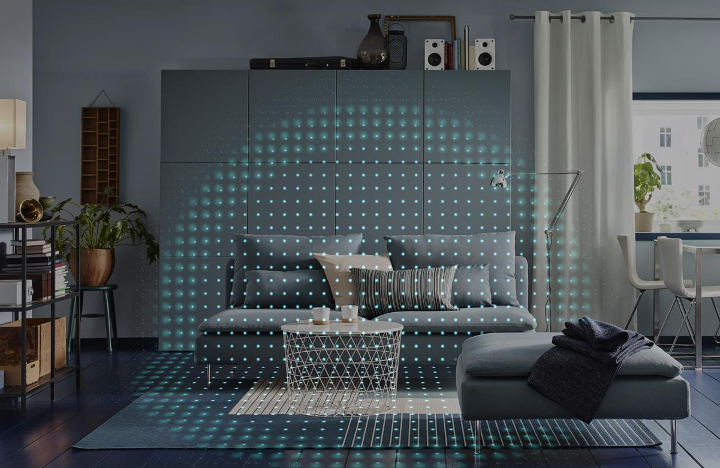
Demonstrating Concept
Notes:
It digitizes the physical world
Maps your surroundings - finds “feature points” and uses those to track your motion (aka “Headpose”)
Creates a mesh to fit your environment
Finds planes and surfaces
Can even recognize objects in your surroundings (coming soon)
Content now lives in the world and respects real world rules
Occlusion

Slide 40
Cool, but how do you USE it?
Notes:
ML1 - *What does it do?
It’s a computer, right?
*So what I’s and O’s does it support?
*How is it progressing HCI?

Slide 41
Outputs
“Fields”
Notes:
Let’s start with the Outputs
To make this computer that is now more tightly paired to your senses than anything ever before
Confused senses = bad user experience (one reason why a lot of people experience
We want to make sure we’re giving your senses the best possible experience in a natural feeling format
We want to be ethical and physiologically conscious to bend the computer to better accommodate the human (not the other way around)

Slide 42

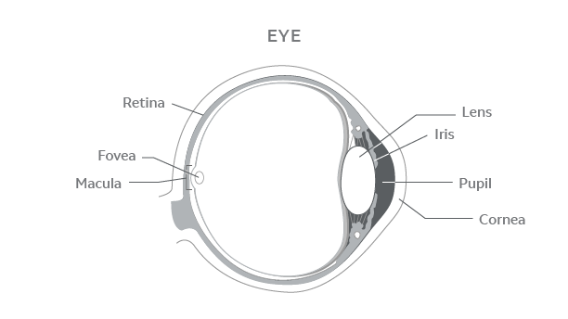
Lightfields -> “Depth Planes”
Notes:
Outputs: With Magic Leap, we use “Fields” to make our content play nicely with your senses and feel natural
*Fields make sure the feedback generated by content that lives in the world around you feels natural and doesn’t confuse your senses.
Necessary for convincing human-centric spatial computing
Nausea or Eye Strain when using VR - mismatch of sensory info between eyes (vergence as well as lense focus), inner ear motion, etc.
*The human sensory system is finely balanced for the real world. If you give it bad or mismatched data, it throws it out of whack!
Lightfield - “Multiple Depth Planes” - we manipulate light to feel as if it is coming from physical space in the world (i.e. not projected onto a flat screen)
Solves for vergence accommodation - your content now tricks your eyes into thinking it’s at the same distance as the physical world around it
Also stereoscopic - each eye gets the perspective that is right for it (adjustable based on your IPD - Inter-Pupilary Distance - which ranges across human head shapes)
Soundfield - “Spatialized Audio” - manipulating audio to sound spatialized in your environment (think IMAX, but wearable)
Mono
Stereo
Surround
IMAX -> We are here!
*Fields make sure the feedback generated by content that lives in the world around you feels natural and doesn’t confuse your senses.
Necessary for convincing human-centric spatial computing

Slide 43
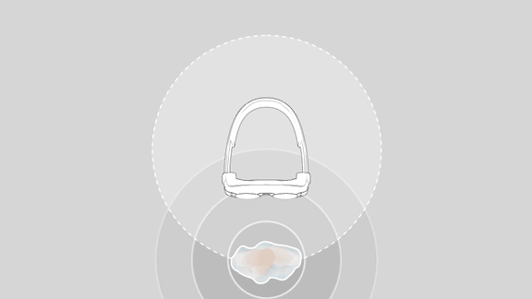
Soundfields -> “Spatialized Audio”
Notes:
Soundfield - “Spatialized Audio” - manipulating audio to sound spatialized in your environment (think IMAX, but wearable)
Mono
Stereo
Surround
IMAX -> We are here!

Slide 44
Input
Modalities
Notes:
*OK, so Magic Leap can place content in the world around you in a convincing way that fools your senses and blends naturally with the physical world
Cool ‘O’
What about the ‘I’ part? How do you interact with it?
What makes it more than just a glorified 3D video player?

Slide 45
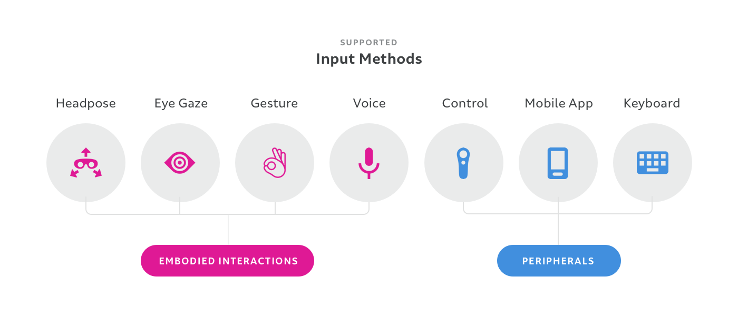
Notes:
Magic Leap supports a wide range of Input Modalities
These are the ones we support natively, but you can also roll your own if you want to bring others into the ecosystem (game controllers, bluetooth controllers, IoT devices, etc.)
Let’s dive in and see what kinds of new Human Computer Interactions we can unlock with these new Inpus then, shall we?

Slide 46
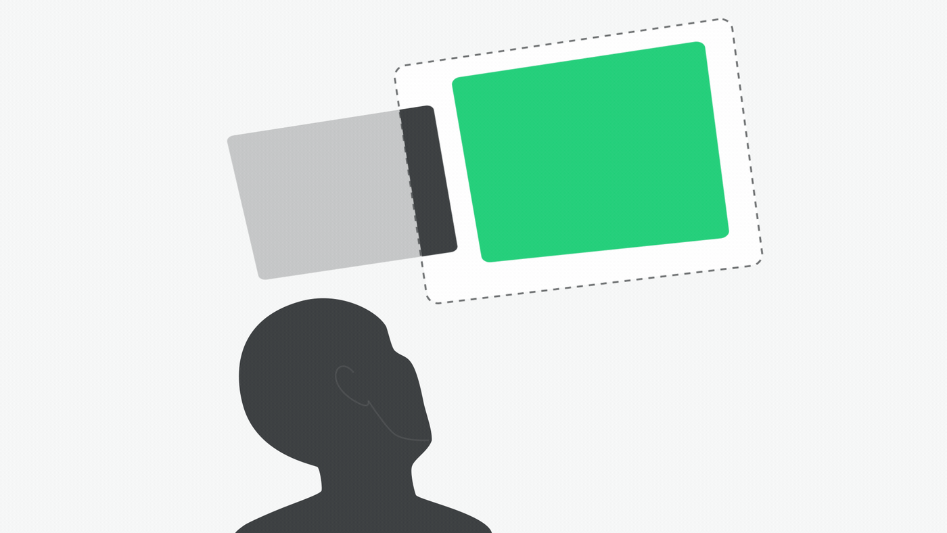
Headpose
Notes:
Headpose - the most fundamental input for a wearable HMD
You get this for FREE if you’re already able to track a user’s motion
*From a 3D engine “rendering” and setup standpoint, Headpose is 1-to-1 with the user’s “Main Camera” - Imagine an invisible digital camera (slightly offset for each eye to get the correct stereoscopic perspective for your IPD)
Your camera moves according to the motion of the user’s HMD

Slide 47
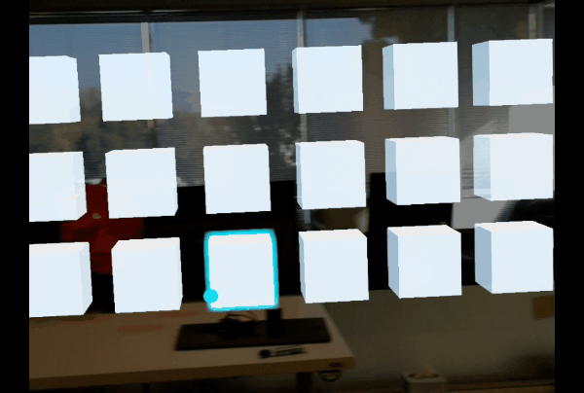
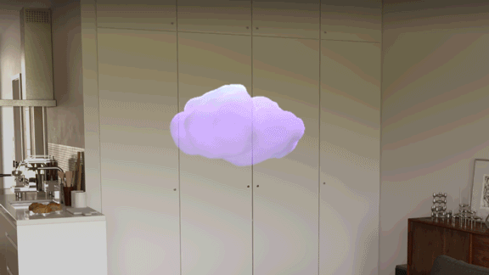
Eye Tracking
Notes:
Eye Tracking
ML can track where your EYES are looking and Vergence
Deliberate Input or for Depth Plane management
ML can track eye open/close and blinks. Can detect if a user is getting sleepy
Also great to understand context - you may want your experience to adapt to focus
Headpose + Eye Tracking is sometimes called “Gaze”
Real World Use Cases:
Training -> “Look at the SHUTDOWN button”
-> If the operators at Three Mile Island had this to help them find that blinking button (and better train them to look for it), they might have avoided the meltdown
Habit Training - Help people with social awkwardness better be aware of their behaviors
Interview practice with a virtual character. Is the user avoiding eye contact? Now you can prompt them to look back (or give them stats on how they did after the exercise)
Medicine and wellness. If you can analyze a user’s vision, you might be able to detect perception issues
Earlier this year my mom had a stroke, and she now has a blind spot that wasn’t there before, which has impacted her reading and writing abilities. This tech could help her learn how to better work around that or be more aware of her new considerations
Also has applications in research
Until now, we really haven’t had great tools for tracking user “focus.” We know things like if you look up and to the side, you might be trying to Imagine or Recall something
*Personally really excited about Eye Tracking

Slide 48
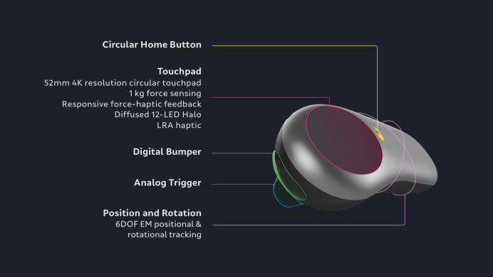
Control Inputs: 6DoF, Touchpad, Trigger, Bumper, Home
Notes:
“Control” - Our physical controller
Uses 6DoF tracking -> position AND orientation in 3 dimensions
Tracks position as I move it around the world
Also tracks rotation, letting me aim and point
Also has a touchpad for more fine motion and micro-motion (can also detect taps, presses, swipes, rotation, etc. - just like your phone does)
Trigger and bumper for physical “grabbing” and selection
“Home” button, because sometimes you just need to quickly go Back or toggle a a Menu
Think of it like a physical tool that can reach into the virtual world

Slide 49
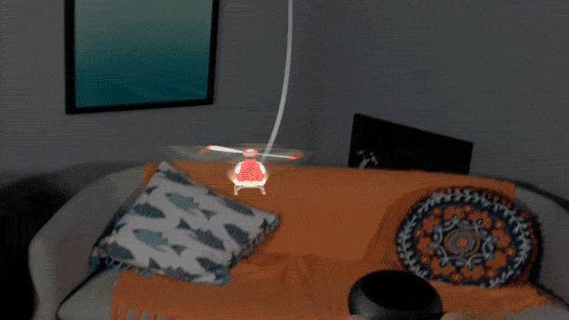
Control Inputs: 3DoF + Touchpad
Notes:
Here’s an example of rotational 3DoF
Example from “Drive” from “Magic Kit”
set of example projects with source that you can download from our creator portal to teach you how to develop for ML1)
Notice how the user here is tilting the control to make the helicopter lean the same direction
Also using the touchpad to pivot the helicopter while flying

Slide 50
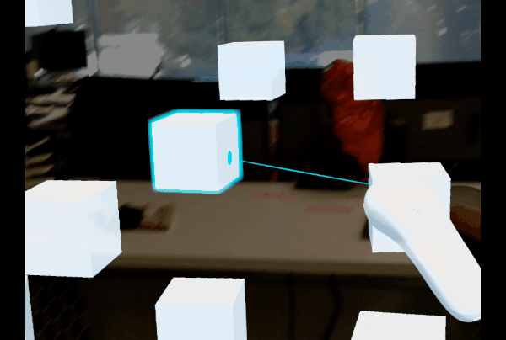
Control Inputs: 6DoF
Notes:
Here’s another example:
Using the Control with full 6DoF like a laser pointer to target things across your room
Notice how the Control is both moving and rotating in physical space
*We call this Indirect Manipulation,
You can also use it with the Trigger like a pair of pliers to physically GRAB and MOVE content in your surroundings
Puzzle Box?
You can also combine Control input modalities in other ways
Use the touchpad with 6DoF to rotate or scale your content while you’re moving it

Slide 51
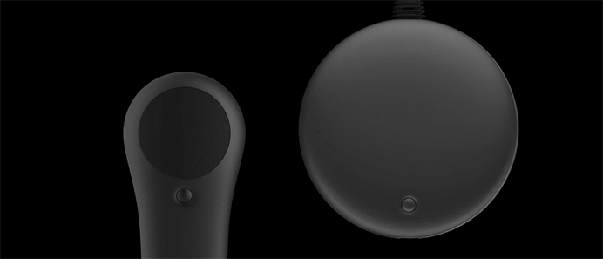
Control Outputs: LED Halo and Haptic Motor
Notes:
Control also has Outputs
LED Ring
Haptic Vibrations
*Great for providing feedback, instruction, etc.
*holograms aren’t yet physical, but we can fake it
*Tell story about turning a nob with “clicks”

Slide 52
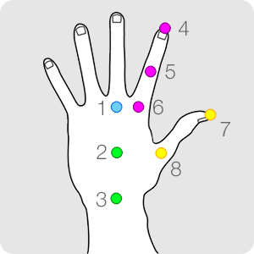
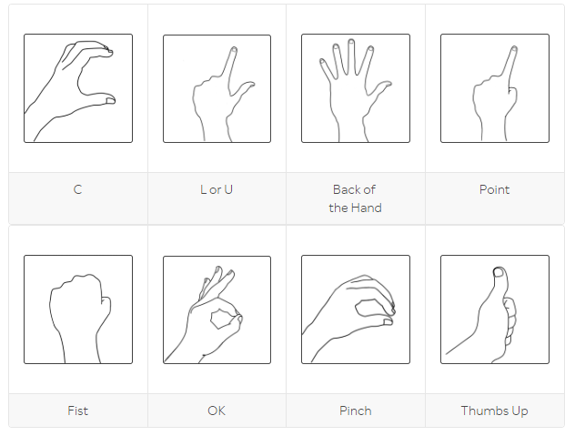
Hand Tracking
Notes:
Hand Tracking
Hands are the original input for humans! Defining of our species! We rely on our hands for nearly everything we do!
To be able to use them directly to interact with content (not through a tool) is a profound opportunity!
Two Aspects:
Feature Tracking - we can detect and track keypoints on your hand to know where it (and your fingers/joints) are in space. Can be used to detect motion over time.
Static Hand Poses - we can also detect certain poses, which can be used to trigger certain actions (like confirmation or to begin an experience)

Slide 53
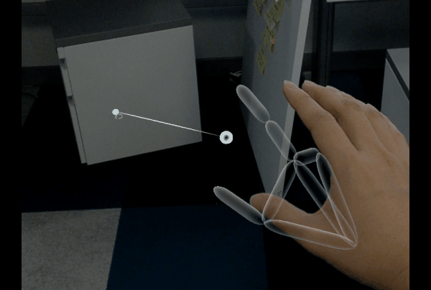
Hand Tracking
Notes:
What kinds of interactions does Hand Tracking unlock?
Use certain static poses as a selector (in combination with headpose) to place content remotely
Video of placement confirmation in Dodge
Can also be used for simple things (don’t wanna get hit in the face? Do what feels natural)
Quick anecdote about “Discoverability” and embracing user expectations
We didn’t support this initial in this experience that was more about interacting with a user’s head, but as we playtested, we repeatedly saw users attempting to block the rocks
In the spirit of embracing natural expectations and building our HCI more around the H than the C, we added this. We don’t need to tell anyone to do it, because they’ll figure it out naturally, driven by pure instinct
Can also use feature tracking to know how content you may be “grabbing” (with a pose like Pinch) should move or rotate as your hand does

Slide 54
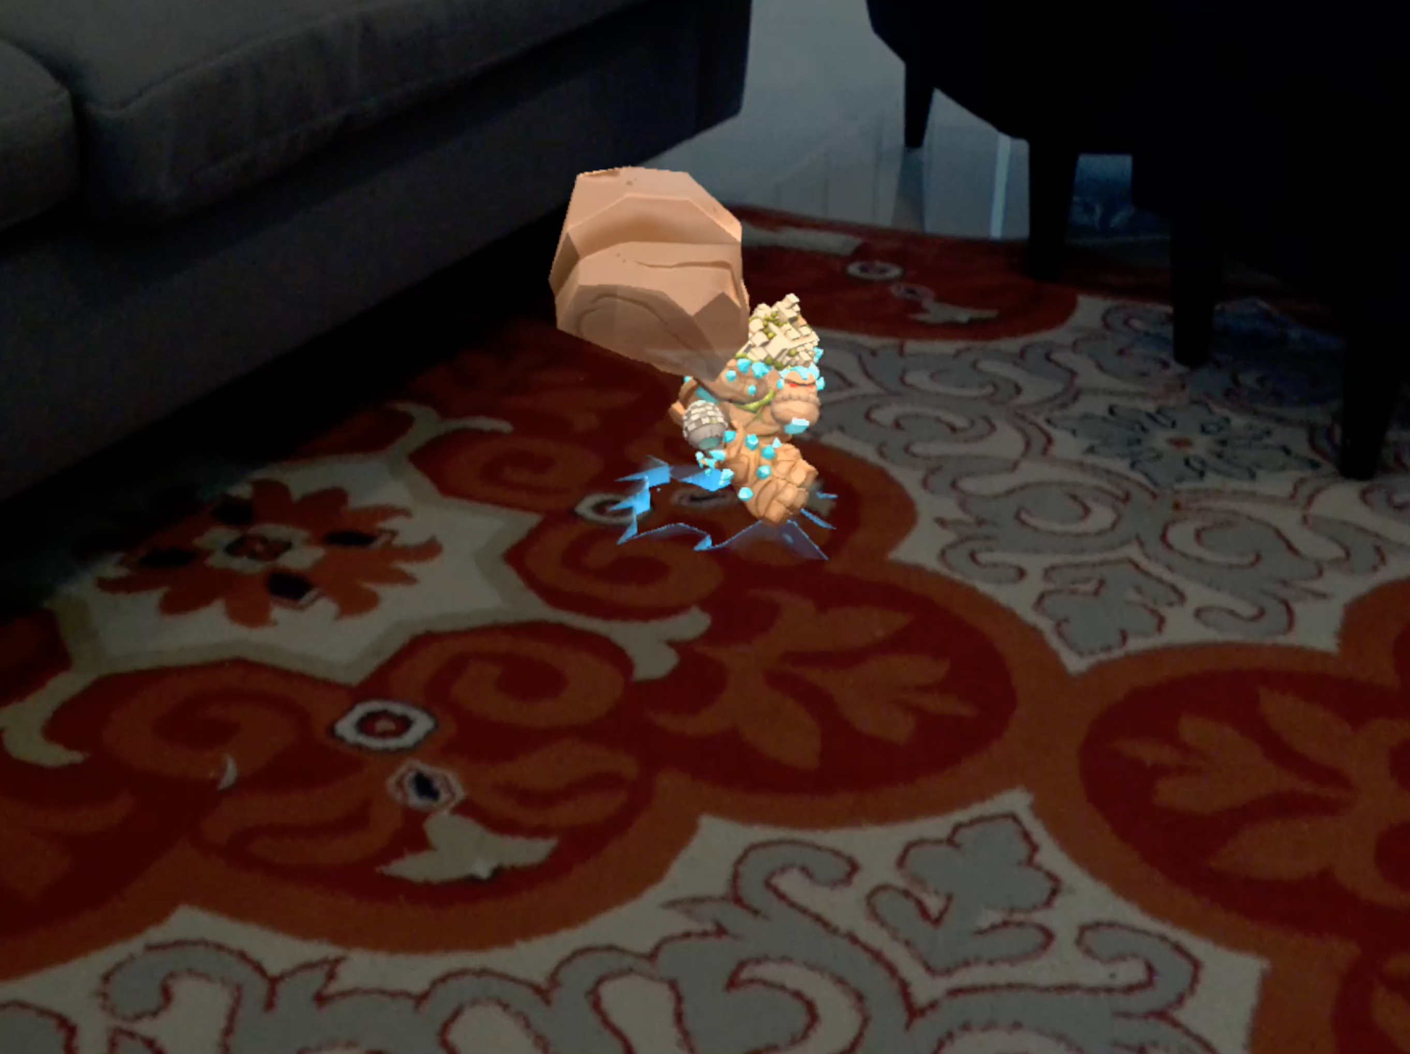
Hand Tracking
Notes:
What kinds of interactions does Hand Tracking unlock?
Use certain static poses as a selector (in combination with headpose) to place content remotely
Video of placement confirmation in Dodge
Can also be used for simple things (don’t wanna get hit in the face? Do what feels natural)
Quick anecdote about “Discoverability” and embracing user expectations
We didn’t support this initial in this experience that was more about interacting with a user’s head, but as we playtested, we repeatedly saw users attempting to block the rocks
In the spirit of embracing natural expectations and building our HCI more around the H than the C, we added this. We don’t need to tell anyone to do it, because they’ll figure it out naturally, driven by pure instinct
Can also use feature tracking to know how content you may be “grabbing” (with a pose like Pinch) should move or rotate as your hand does

Slide 55
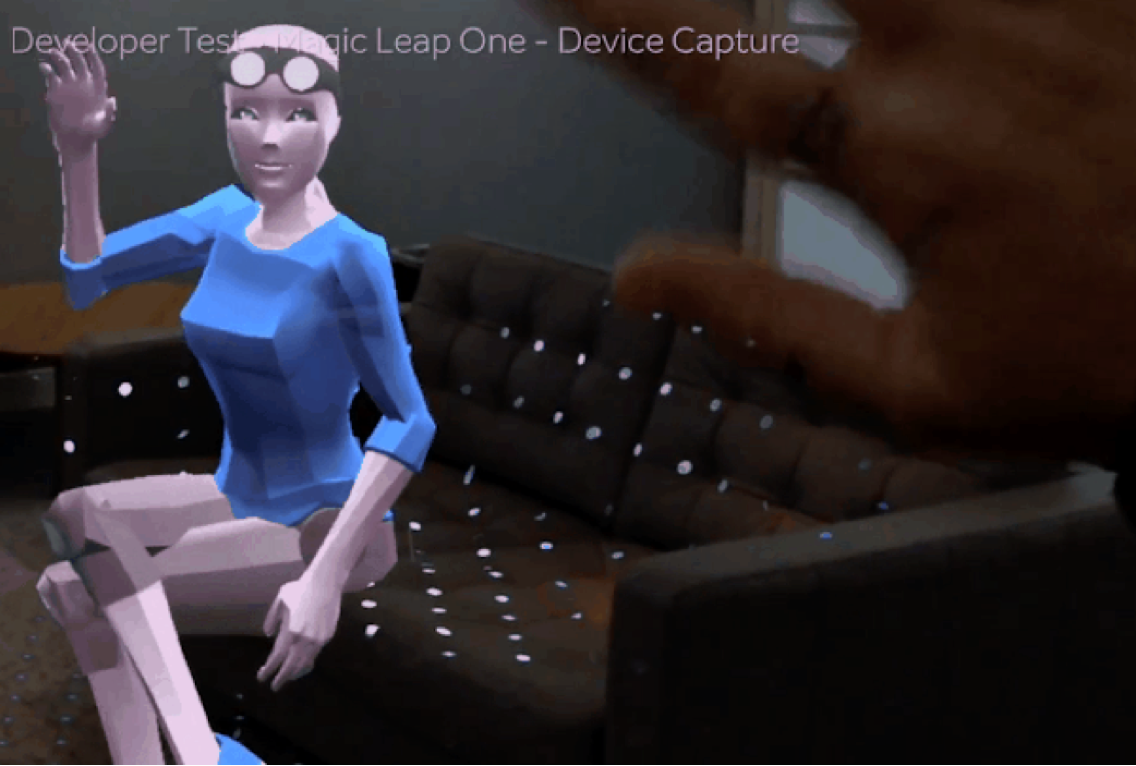
Hand Tracking
Notes:
Another fun example of a natural way of using hands

Slide 56
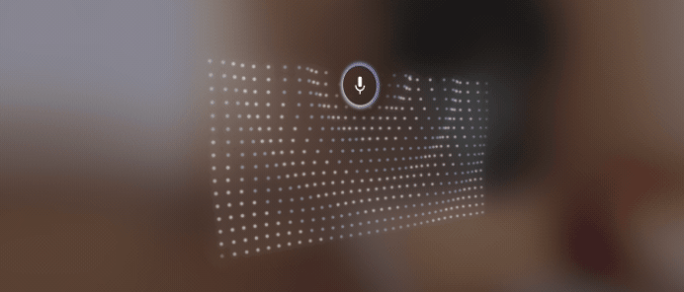
Mic and Speech
Notes:
Speech and the Mic
Inward and Outward Facing Mics – as you already know, Speech is very powerful – being able to talk to your computer
Can also record a user if you wanted to make a training session someone can play back
Beyond that though, you could also detect things like breath – Training: User is Tired or stressed, you can react accordingly

Slide 57
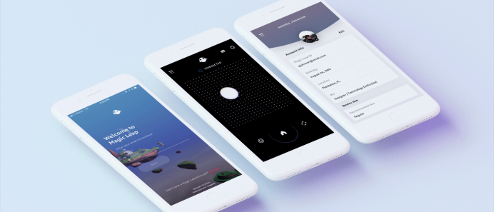
Magic Leap Mobile App
Notes:
Magic Leap’s Mobile App
A mobile app that integrates seamlessly with the ML OS
OS features such as text entry and integration with our Gallery
Can also be integrated into your own custom apps as an input method
Can detect screen Taps, Holds, Drags, and Swipes - can match our Control in these ways without requiring a new gadget to carry
*Many more cool features to come!

Slide 58
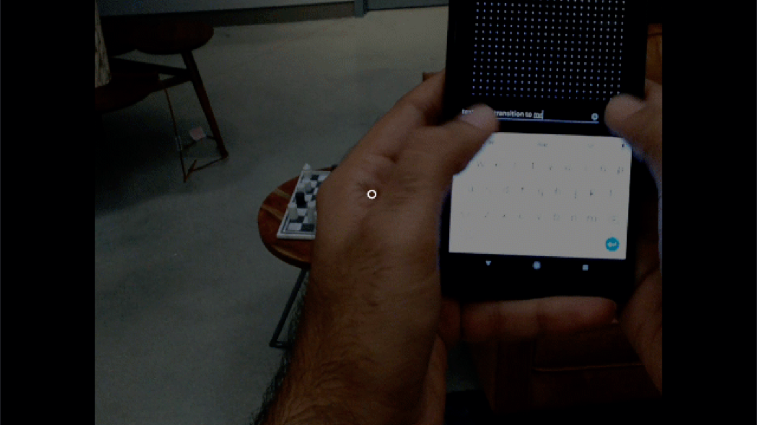
Magic Leap Mobile App
Notes:
MLMA Uses
Text entry -> still unsolved for MR, but with this approach you can do no worse than existing Mobile input methods
With autocorrect and other niceties can average around ~30 wpm
*Many more cool features to come!

Slide 59
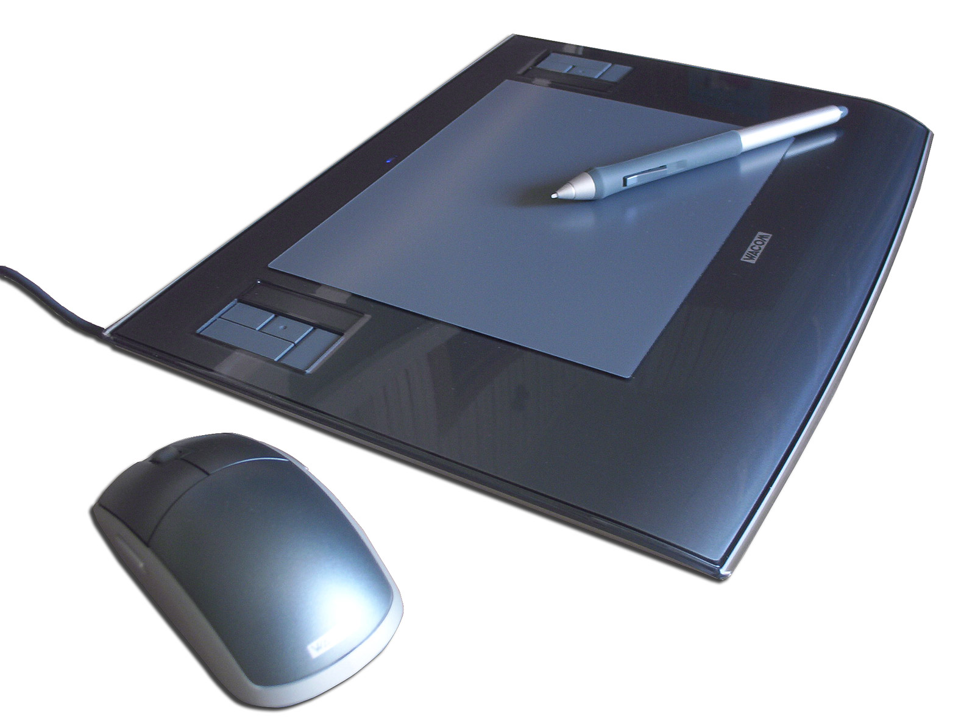
If It Can Connect...
Notes:
You can also roll your own!
Bluetooth controller
Game controllers
Keyboard and Mouse (BT Keyboards are natively supported already)
IoT Devices
Tablet with Stylus -> WACOM partnership announced!
*If it can network, it can be used!

Slide 60
Combining Input Modalities
Notes:
We just covered some of our distinct native input modalities and what they can be used for
Really powerful stuff!
But that’s really just scratching the surface
The REAL potential comes when you start combining modalities in different ways
Remember earlier when we talked about how being able to Move, Run, AND Jump in the original Mario was a big deal?
Going to go over a few cool combos now. Keep in mind...
More options = more potential use cases (but potentially worse usability if you’re not careful or redundant
More modalities = potential higher throughput of actions
If you don’t have to target and select with the same input (i.e. low level headpose), you can

Slide 61
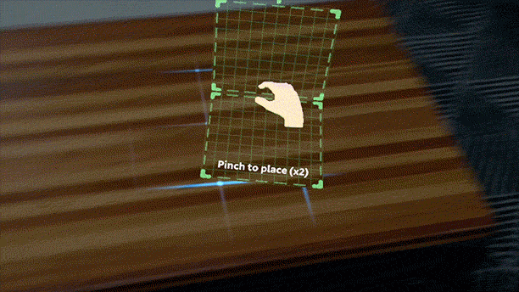
Headpose + Hand Tracking
Notes:
First, here are a few very simple and tangible examples
Magic Kit Lesson - Dodge:
Headpose + Gestures
Headpose used to target the world
Gestures used to confirm (like a “click”)

Slide 62
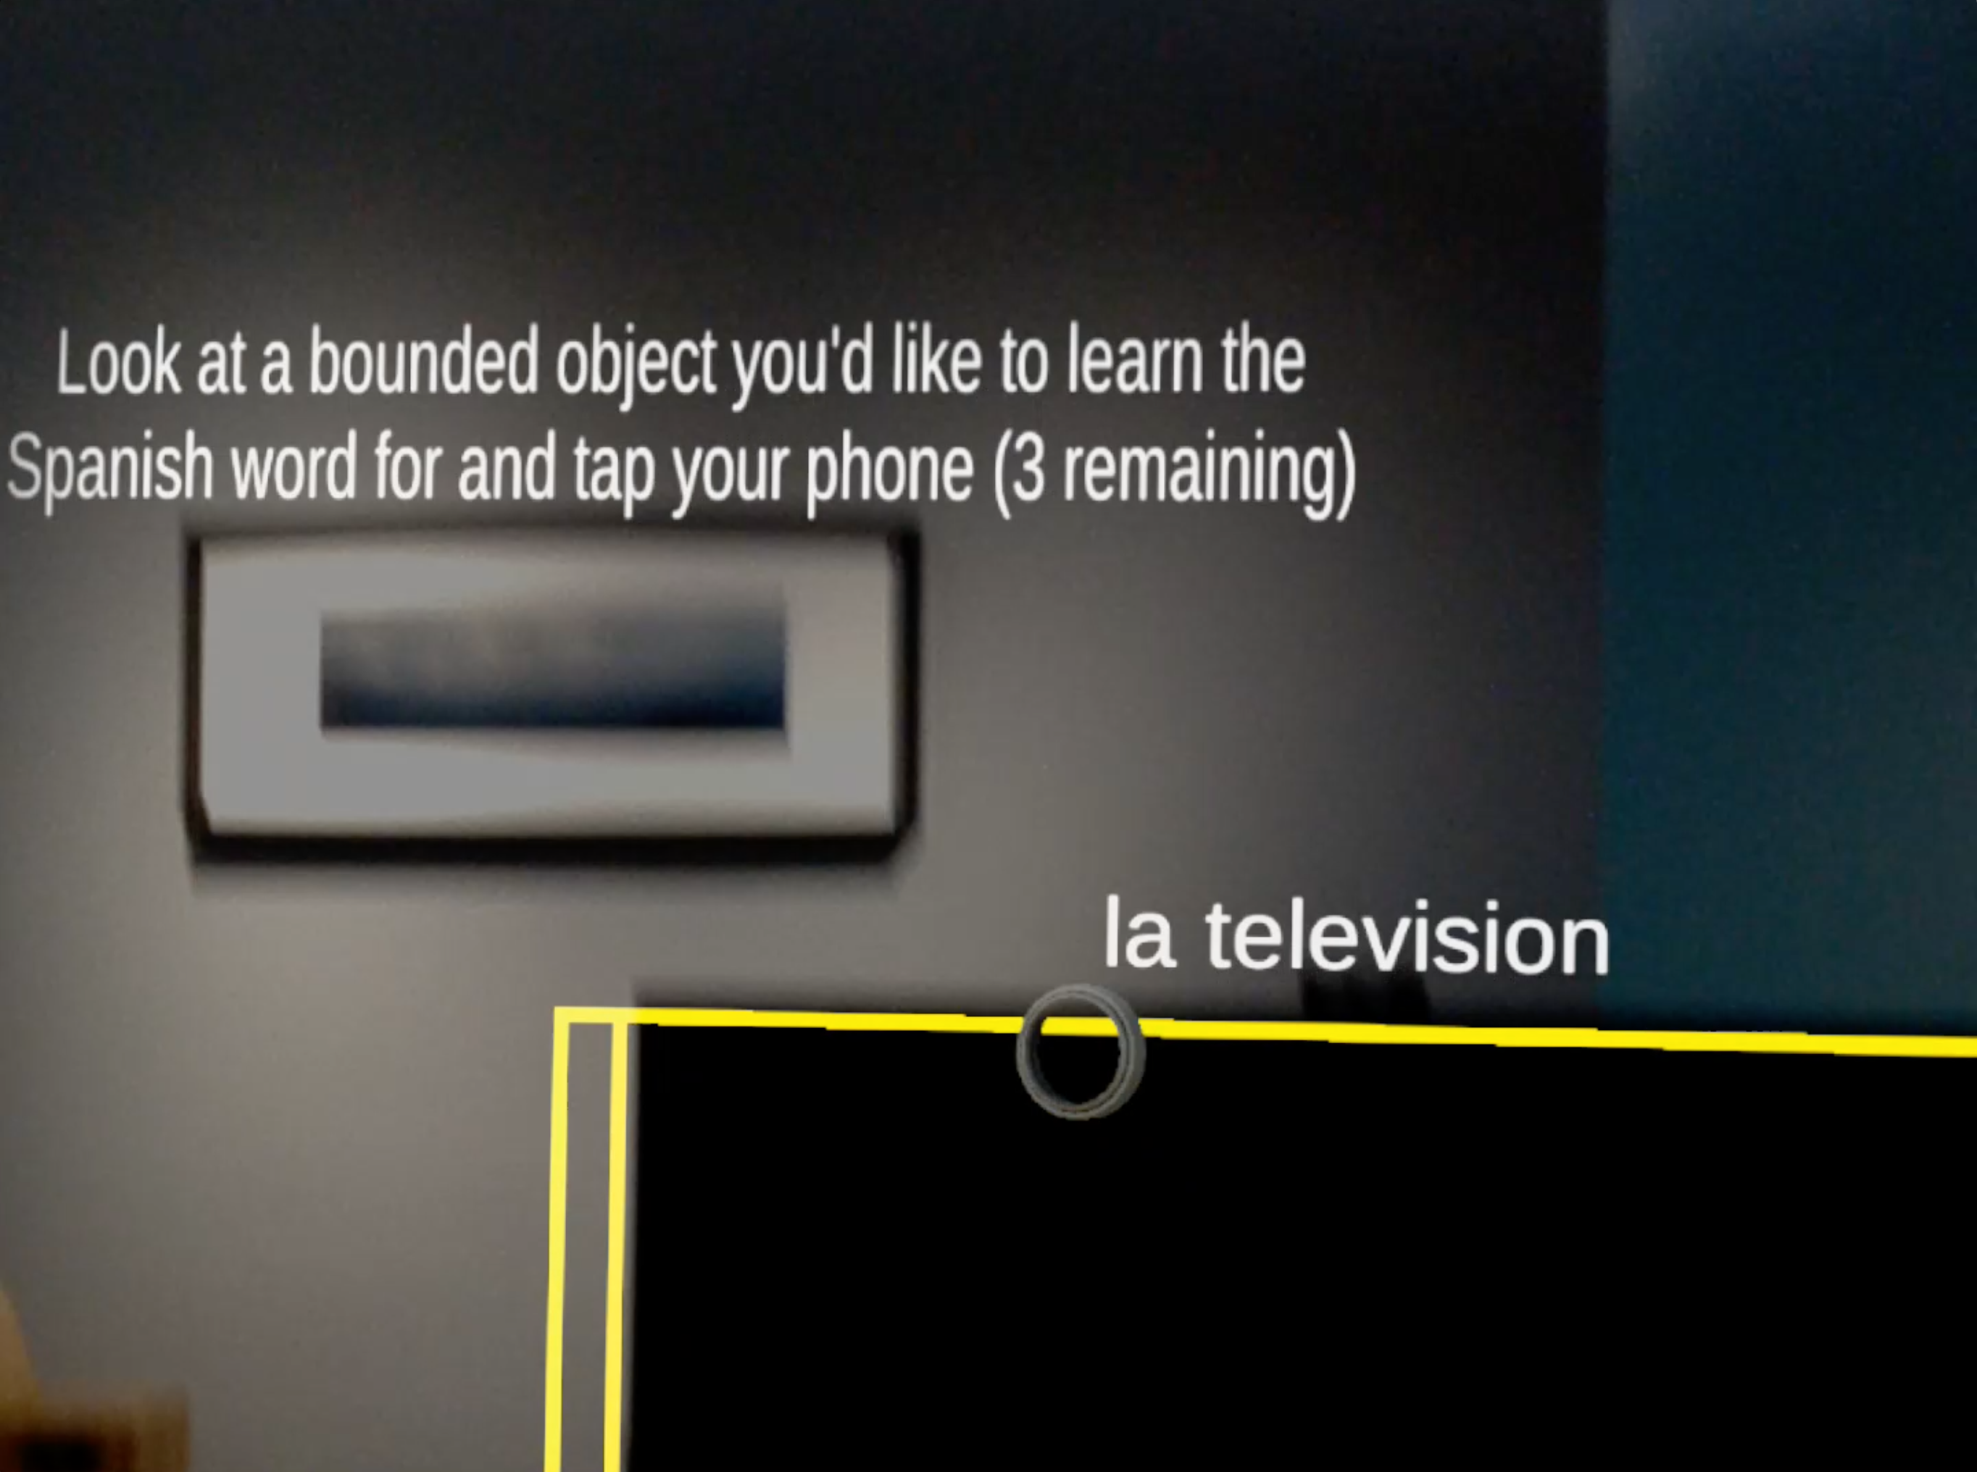
Headpose + Phone Inputs + Object Recognition
Notes:
An example from a Language Learning prototype we created internally to test Object Recognition:
(Custom) Mobile App + Gaze
Gaze to highlight objects
Mobile app to confirm/select
Also used for text entry
And includes a custom UI

Slide 63
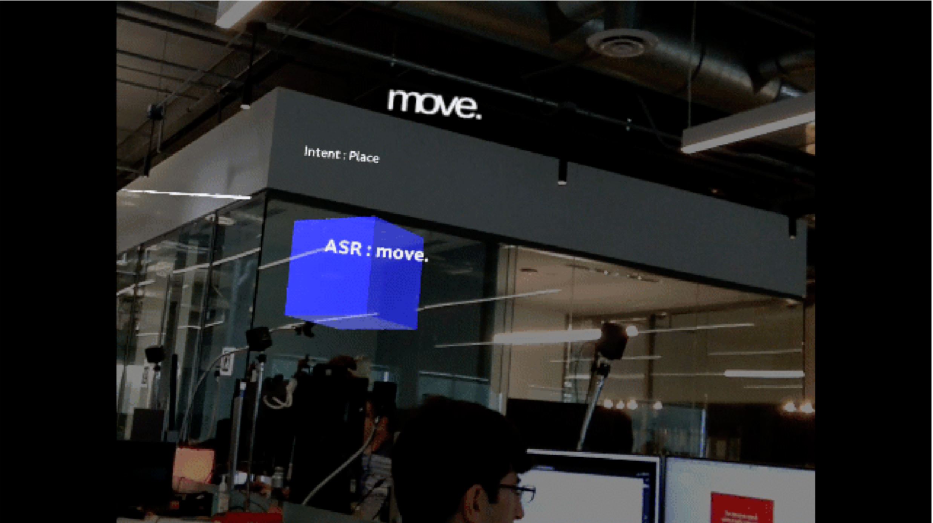
Speech + Gaze
Notes:
“Put That There”
Speech + Gaze to infer location (tied to utterance)

Slide 64

Attention, Prediction, & Intent
Notes:
User Attention and Prediction
*You can also combine modalities in ways that allow you to get predictive
When I go to pick up this bottle of water, I do a few things
*This sequence is true for largely every human
*Part of our core perception and physiology
First I begin looking at the object
Eyes lead
Head follows
Then, once located/targeted, my hand begins the long (slow compared to eyes) journey of reaching for it
Uses proprioception with gaze to help aim
Grab - gets tactile / haptic feedback

Slide 65


Recap
Trends in HCI & I/O
Why it Matters
How Magic Leap Fits
Where We’re Heading
Notes:
Where we’ve been and where we’re going
Why we’re going there (Democratizing Computing & Avoiding the next Three Mile Isle incident)
Striving to be the next great milestone in human-centered computing
How this can be used and a brief glimpse into the future

Slide 66

Notes:
The future of HCI is now!

Slide 67

For More Info...
https://creator.magicleap.com/learn/guides/magickit-overview
Notes:
For more info, check out the Magic Kit Sample Projects and documentation on our creator portal

Slide 68
Thank You!
cbryant@magicleap.com @OldKingColman
Notes:
If you want to come try the future of HCI for yourself, find us in the Pacific Floor this afternoon from 2-4pm
If you want to see another truly next gen input (one step closer to mind reading even) stick around here for the CTRLlabs talk next for a glimpse into a neural interface

